Slide 1
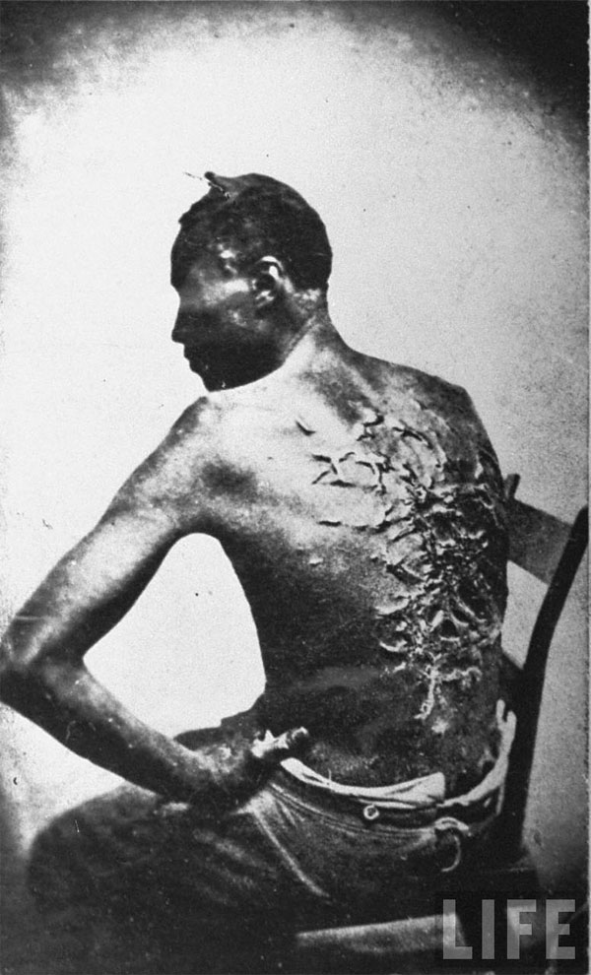
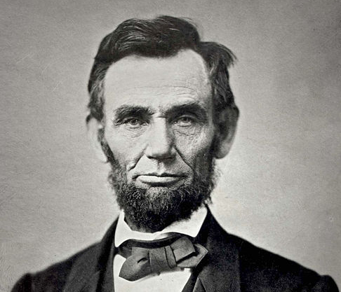
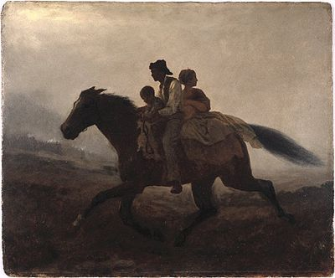
The Causes of the American Civil War

Slide 2
Enter causes menu here …
Download FREE supporting resources here …
Useful 1860 election political map …
Excellent summary here … other videos are linked throughout the resource.

Slide 3
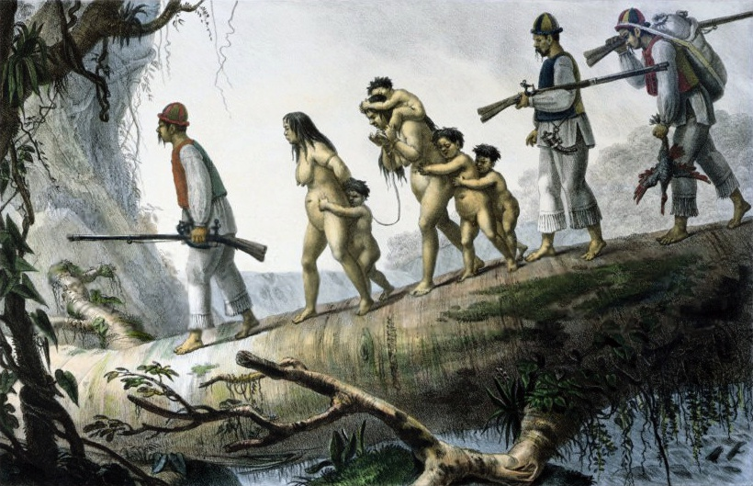
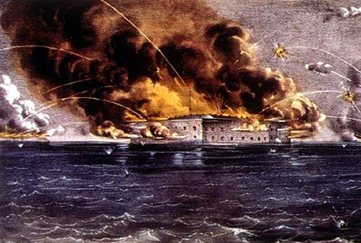
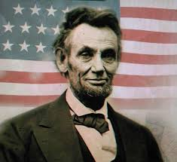
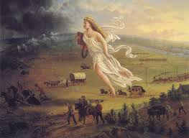
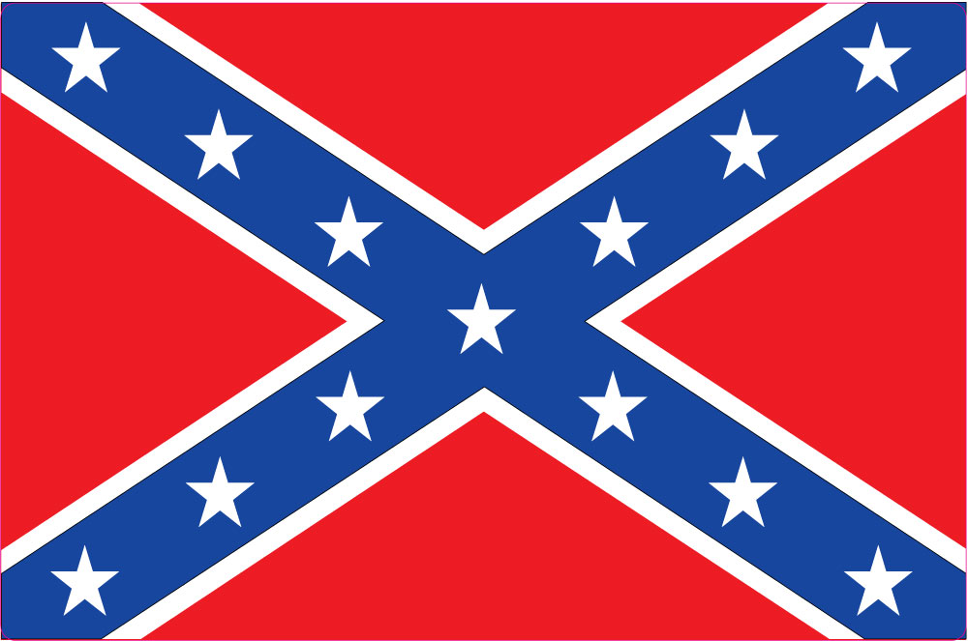
Starter… guess the causes of the American Civil War.
Click on each image to find out more.

Slide 4
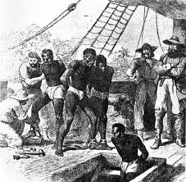
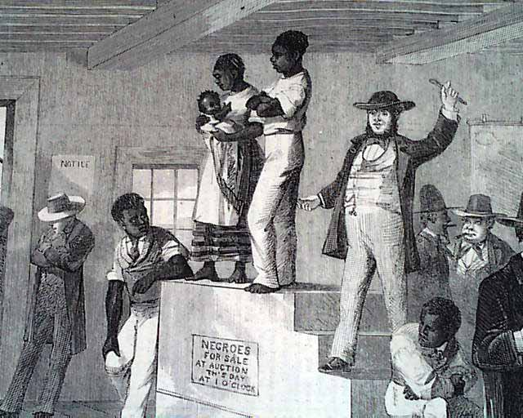
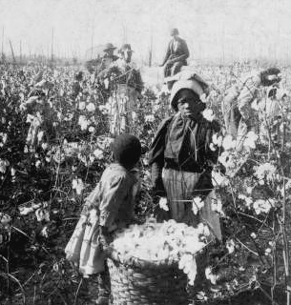
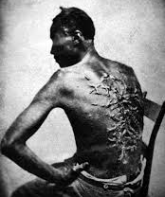
Southern Slavery
Captured
Auctioned
Worked
Whipped
The first slaves were shipped from the African continent to the New World in the early 1500s. They were used to harvest cotton, sugar and tobacco in the Caribbean and Southern United States. Slave were a very important part of the economy in the South. Although slavery was illegal in the North much of the cotton picked was manufactured in northern factories. In the North there was a growing feeling that slavery was a ‘stain on the nation’ and an embarrassment for the USA.

Slide 5
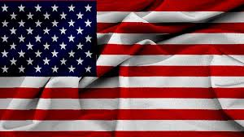
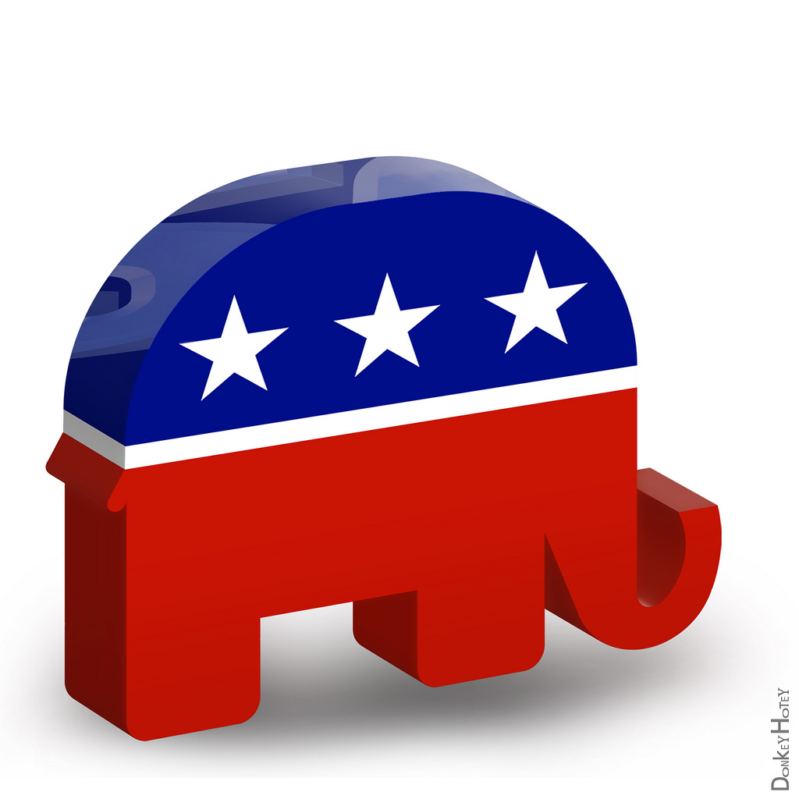
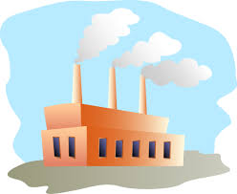
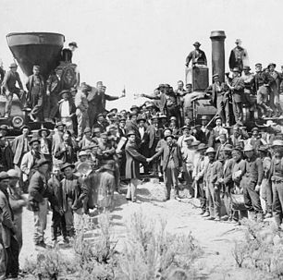
Sectionalism
By 1860 America the North and South were very different places. They had different outlooks, landscapes, economies and different values. Even some Southerners disagreed with slavery but felt strongly that Northerners and the Federal Government did not have the right to interfere with how their state was run. The North feared that the country was being led by influential Southerners in Congress and the Supreme Court Guess where each of the images below belongs, North or South, then click on the images to reveal the answer.
Union
State’s
Rights before Federal
Confederacy
States’ Rights | Republicans | Hunting | Industrial | Agrarian | Railroad

Slide 6
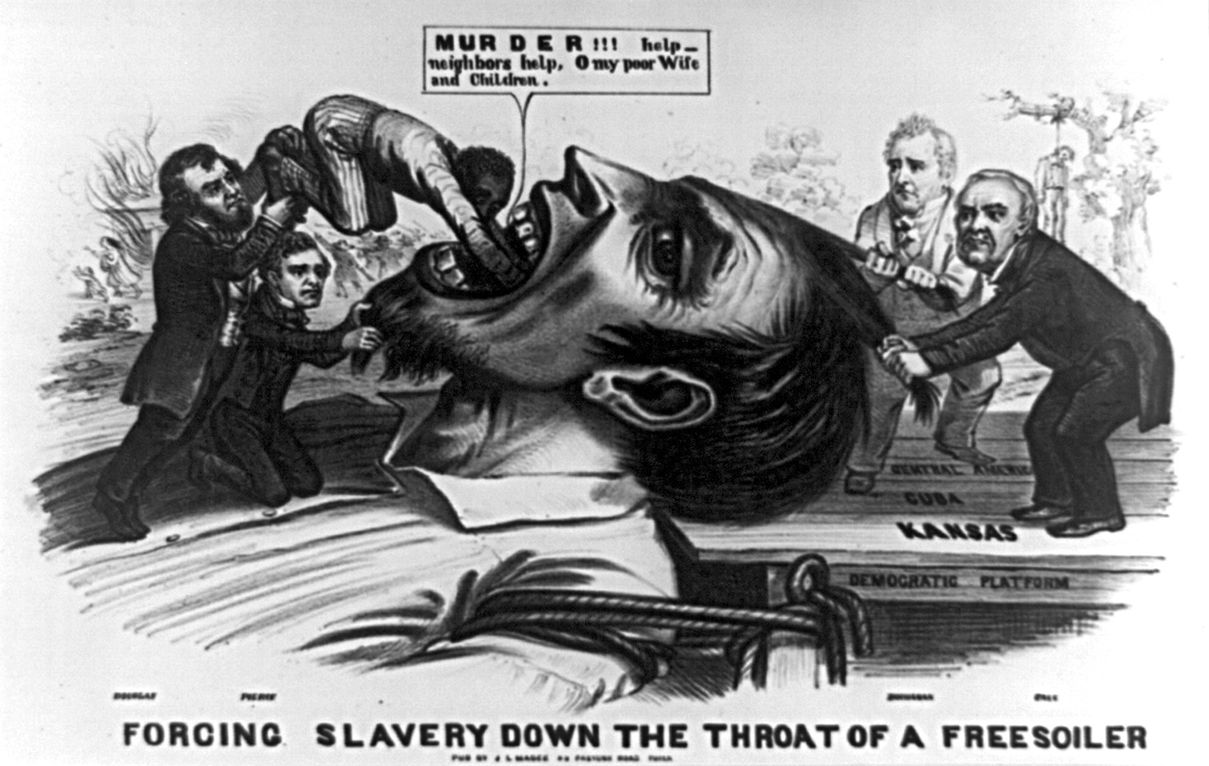
Westward Expansion
There had been an uneasy truce between the North and South before 1820. In the seats of government ( the Senate ) power was finely balanced between Free States and Slave States. This ensured that neither section held more power than the other. Westward expansion would threaten this balance of power. Manifest destiny and the call to ‘Go West Young Man’ was heard, settlers went west. As new territory opened up it had to be decided if it would be ‘free’ or ‘slave’. The 1854 Kansas Nebraska Act would crank up tensions and push the United States closer to civil war.
1820 Missouri Compromise | 1850 Compromise | 1854 Kansas – Nebraska Act | 1854 ‘Bleeding Kansas’
Missouri formed as a slave state but made slavery illegal in the North. | California enters as a free state. Fugitive slave law says escaped slaves found in the North must be returned to the South. | These new territories to decide if free or slave based on popular sovereignty – voted by those who settled there. Undid 1820 Compromise. | ‘Pro slavers’ and ‘Free Soilers’ rushed in to settle Kansas. Led to widespread violence and murder in this ‘proxy war’.

Slide 7
The Secession
Following his election in 1860, President Abraham Lincoln tried to reassure the South that he had no plans to abolish slavery. This reassurance was not enough. South Carolina had a history of threatening to break away from the United States – but it was still a surprise when they voted in favour to secession. South Carolina called for other slave states to join them. Mississippi, Florida, Alabama, Georgia, Louisiana, and Texas did. On April 12, the Confederates opened fire on the Federal garrison at Fort Sumter. War had begun. Lincoln called for volunteers to put down the Southern rebellion. Virginia, Arkansas, North Carolina and Tennessee, believing that Lincoln had acted beyond his presidential power then joined the Confederacy.
November 6th 1869 Lincoln Elected As President | Dec 20th , 1860 South Caroline Secedes | April 12th, 1861 Confederates Attack Fort Sumter
Southerners see this as a Northern attack on their way of life. | Six other states soon join South Carolina in breaking away from the USA. President Lincoln refuses to accept they have the right to secede. | The war has begun and battle lines drawn. States decide which side they will fight for. A few stay out at first.

Slide 8
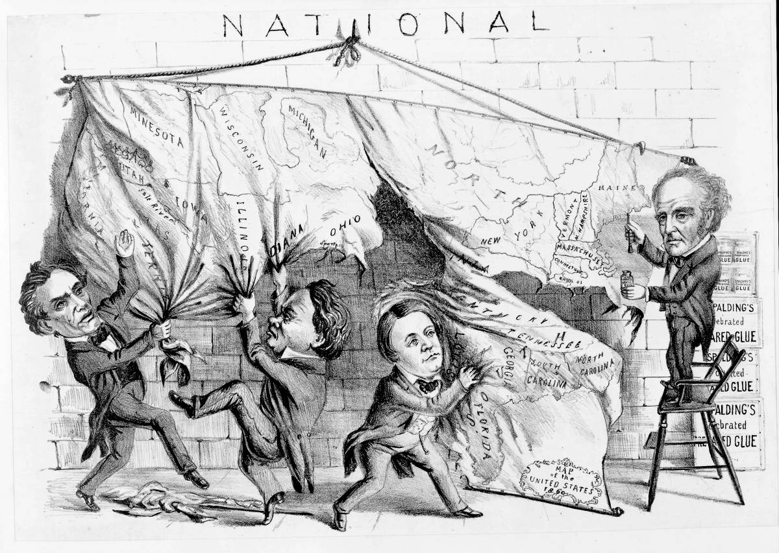
The 1860 Election
Abraham Lincoln was not expected to win the presidential election of 1860. However, the Democrat Party split and opted to field two candidates, one in the North and one in the South. This decision effectively handed the presidency to Lincoln. Lincoln was openly against the expansion of slavery but said he would not interfere with it where it already existed. Southerners saw Lincoln’s victory as a direct attack on slavery from the North.
Many important southern Democrats actually wanted their party to lose. It was an excuse for them to leave the Union. And they believed that secession would be peaceful. One Fire-Eater [ pro-slavery extremist ] once said, "You could slap a Yankee and he'll sue you, but he won't fight back," and that was their assumption. So actually, on election night when news arrived to Charleston that Lincoln had won, there were celebrations, fireworks and bonfires. www.usanew.com

Slide 9
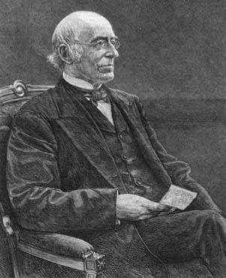
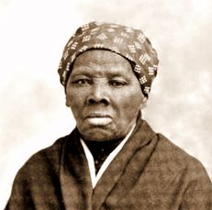
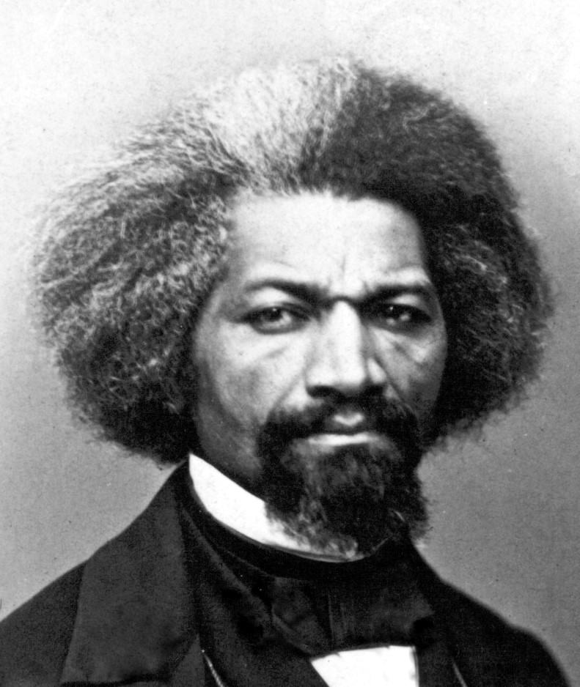
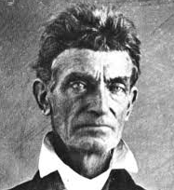
The Abolitionists
William Garrison |  | A journalist who edited the anti-slavery newspaper ‘The Liberator’ | ‘I will not retreat a single inch AND I WILL BE HEARD’
Harriet Tubman |  | Born into slavery and badly beaten Harriet escaped from slavery – before returning many times to help dozens more escape to freedom. | “If you hear the dogs, keep going. If you see the torches in the woods, If you want a taste of freedom, keep going.”
Frederick Douglass |  | Escaped from slavery before devoting his life to giving eloquent speeches and writing powerful accounts against the evils of slavery. | “I prayed for freedom for twenty years, but received no answer until I prayed with my legs”
John Brown |  | He tried to raise an army to free slaves in Virginia. He was executed for treason after leading 21 others on a raid to capture weapons from the government. | I have only a short time to live, only one death to die, and I will die fighting for this cause’.
Abolitionists were people who actively worked to put an end (abolish) slavery. Abolitionists took many forms ; Northerners, Southerners, male, female, white and black. They used various methods to help bring an end to slavery from political speeches, helping slaves escape, writing books and even with armed force. The growth and influence of the abolitionist movement infuriated pro-slavers and led to raised tensions.

Slide 10
