Slide 1
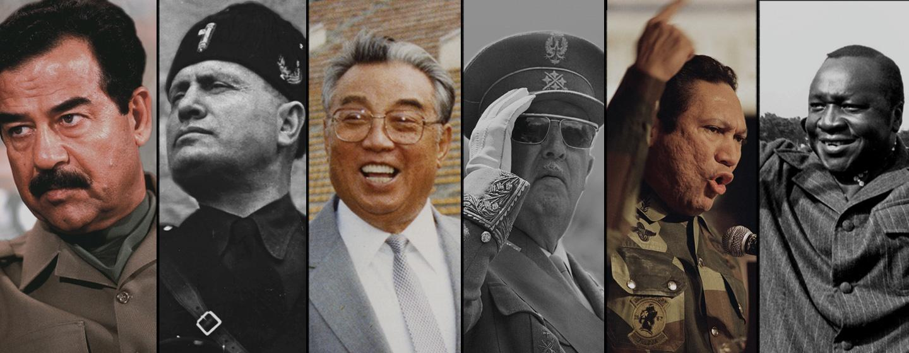

Slide 2
Navigation …
- Return to main menu ...
- Go back to previous page ...
- Go to next page ...
- Click for supporting PDF ...
- Click for embedded videos …

Slide 3
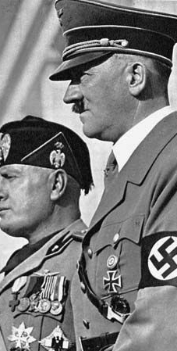
Dictatorship
Playbook
Rogues
More …

Slide 4
What is a Dictator?
A dictator is a person who has complete or almost complete control over a country - creates an authoritarian regime. They usually emerge as a populist, right wing, nationalist or take over in a communist system or following a communist revolution. - Populist = a person who claims to represent the ordinary person and not the rich or elite. - Nationalist = a person who loves or claims to love their country. - Right Wing = a system of rule with a strict government that creates rules and laws - Communism = a political ideology in which all people are supposed to be equal. Often gets corrupted and quickly becomes right wing in nature. - Authoritarian Regime = strict rule of government with few personal freedoms.

Slide 5
Relevant Resources
There are further, supporting resources that may be of value …. - Propaganda = www.ichistory.com/propaganda.html - Dictators = www.ichistory.com/the-dictators.html - Bias = www.ichistory.com/bias.html - Russia = www.ichistory.com/russia-1900---182.html - Nazi Germany = www.ichistory.com/the-nazi-regime.html - Gulf War = www.ichistory.com/gulf-1970---2000.html

Slide 6
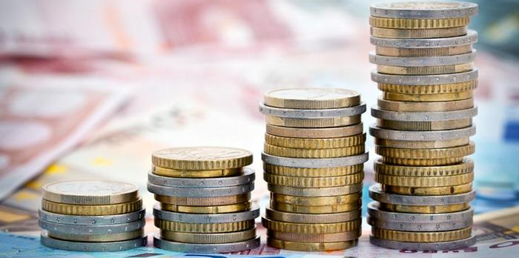
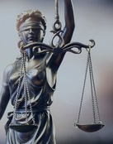
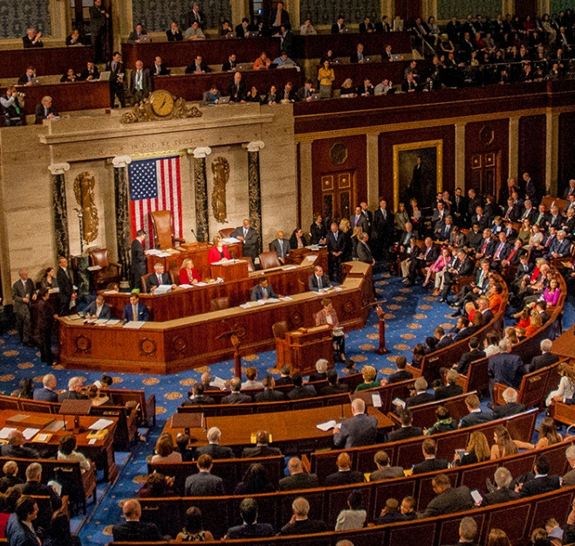
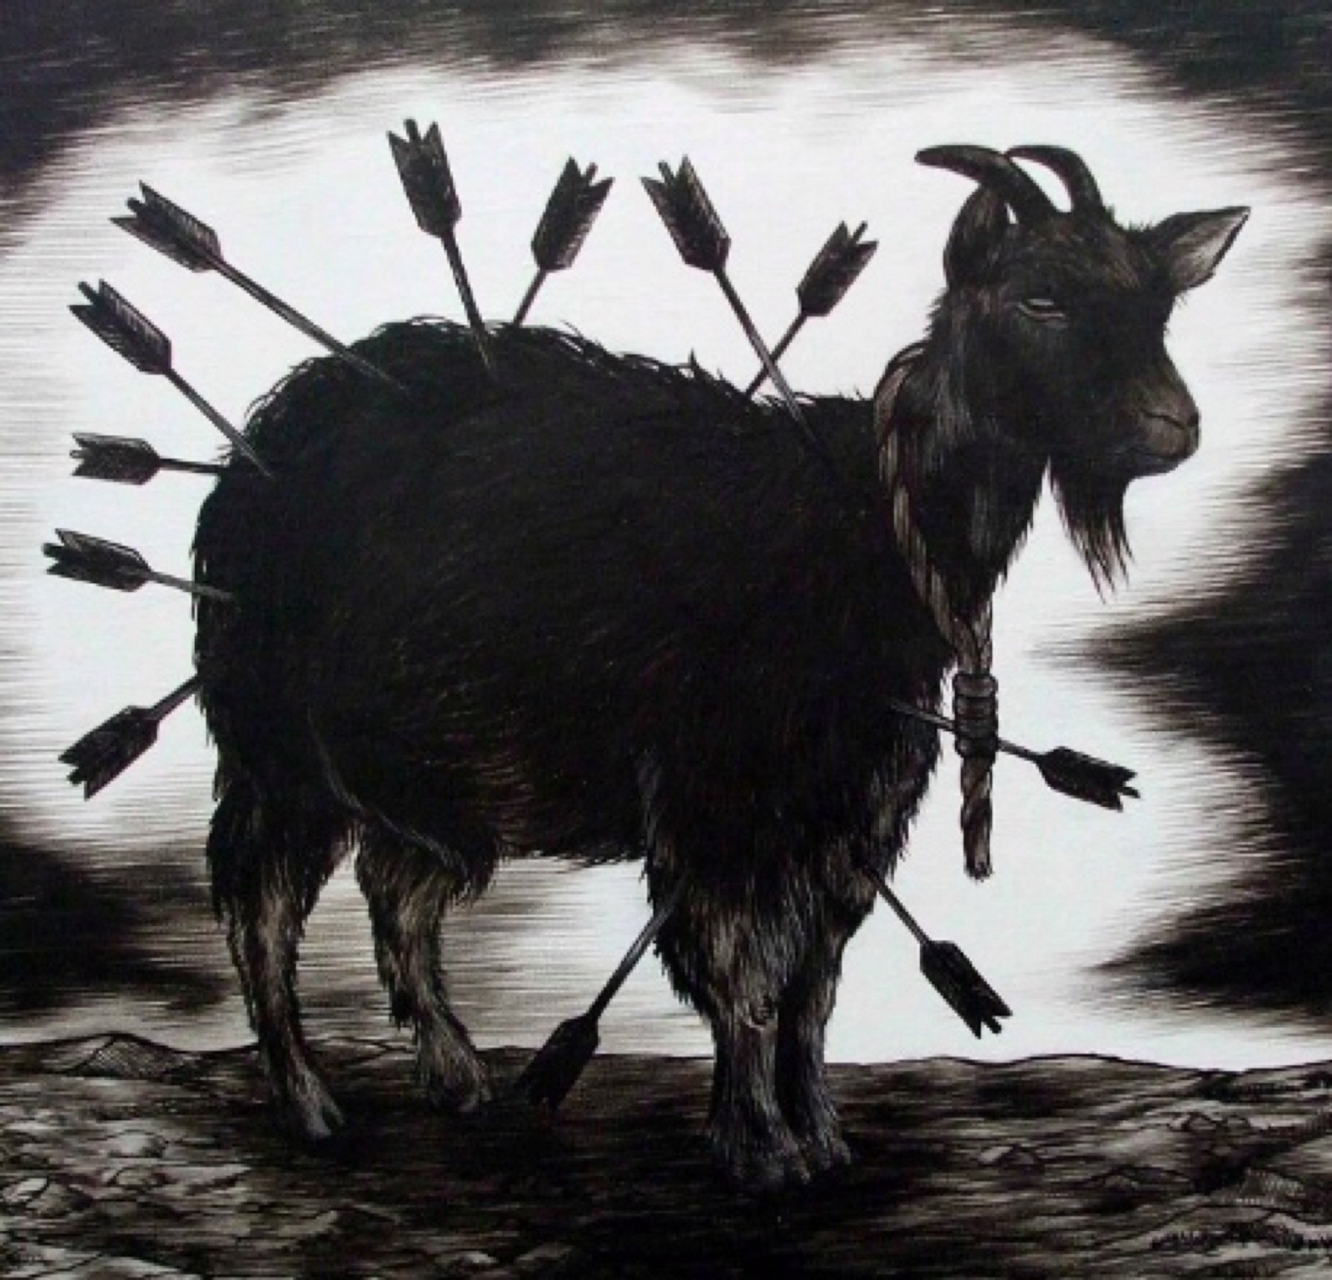
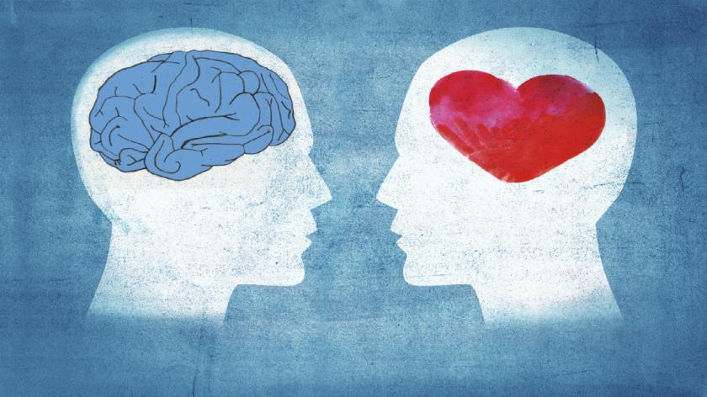
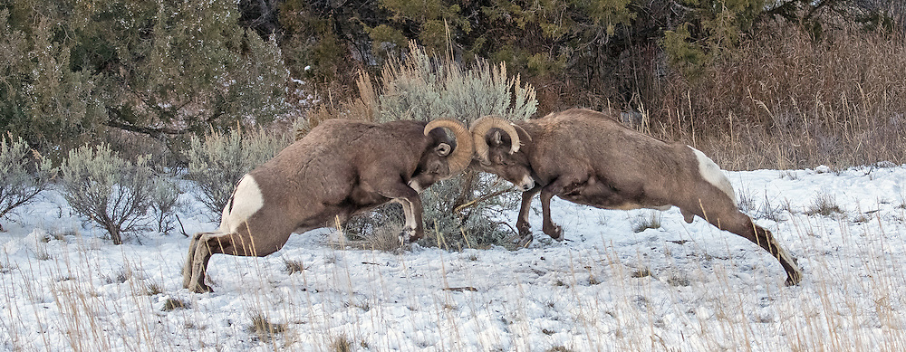
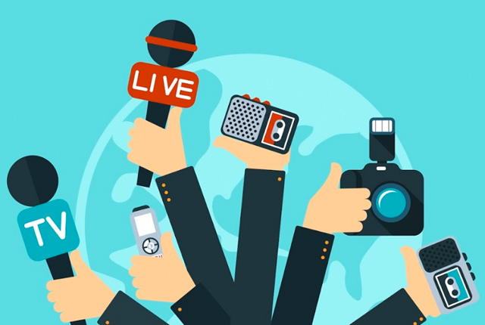
Be a Control Freak!
Starter – imagine you want to be the all powerful leader ( dictator ) of a country. Each image represents an area of the country that needs to be controlled. Can you guess what each of the images represent? ( Click on images to reveal the answers)

Slide 7
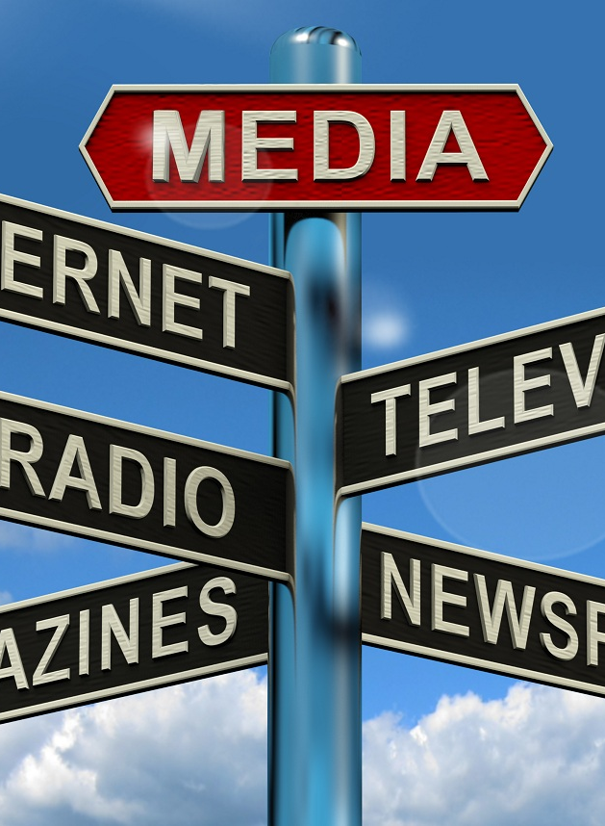
Media - for propaganda
A solid dictator needs to control the information that is allowed to reach people’s eyes and ears. To do this effectively dictators will manage or block the media – including radio, television and presently, social media. Dictators will create their own state sponsored media and / or ensure that existing media is taken over by people who spew their propaganda. A common propaganda trick is to create an ‘enemy or scapegoat’ … usually a minority group ( such as immigrants) then indoctrinate/ brainwash people to make them think the ‘other’ is out to harm them in some way.

Slide 8
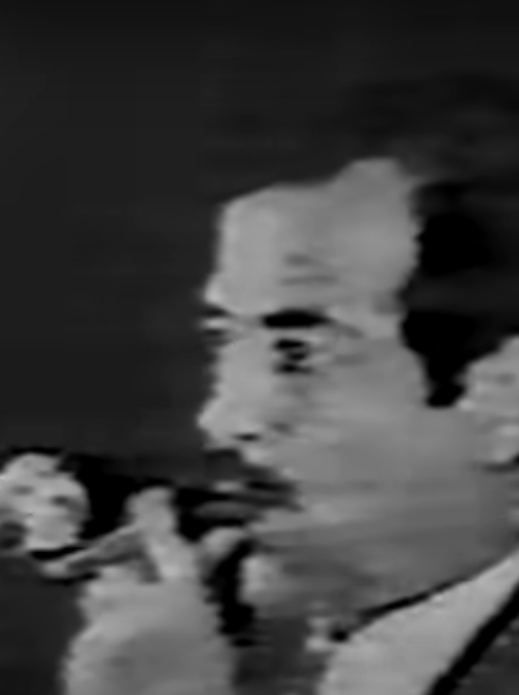
Rivals - Internal Opposition
A wannabee dictator is probably will not be the only person in the country who wants to lead it. These rivals must be taken out. This can be done in a number of ways. 1 -- Discredit opponents using the propaganda machine to make up negative stories or scandals about them. Destroy their reputation. 2 -- Have opponents, arrested on made up charges. Bribery, corruption or tax evasion are easy enough.
3 -- Have them murdered, accidents, suicides or mysterious poisonings work well.

Slide 9
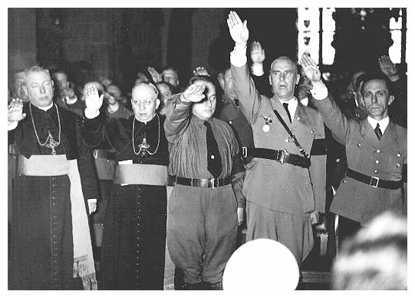
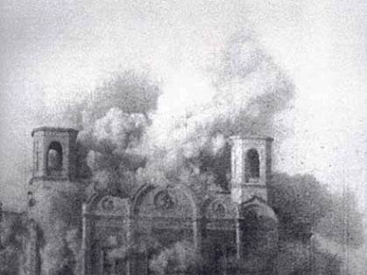
Religion
One barrier to becoming an all powerful leader of a country is the established religion. Not only do religious texts such as the Bible, Quran or Torah represent a danger to a dictator – but so to do the leaders who preach to the people in churches, mosques or synagogues. Why is it difficult for dictators to silence religious leaders and change people’s religious beliefs if their values clash with theirs?

Slide 10
Winning Hearts + Minds
Although a heathy dose of fear and terror is a very effective way to control people – most dictators will get a much deeper sense of satisfaction if they win over the hearts and minds of the population.
To do this dictators must really understand how to use propaganda, to touch the emotions of the population. Dictators often propagandise themselves as a heroic, paternal figures who are in touch with the common person. Dictators make ‘their types of people’ feel like they are special and part of a greater national community. The best dictators actually improve peoples’ lives with reforms that benefit true followers – often by taking things away from minority groups.

Slide 11
Economy
A powerful dictator will have control of and ideally improve the economy. They will aim to seize the country’s valuable assets such as … - Energy - oil and gas. - Manufacturing - cars. - Industry - steel. Dictators also need to make sure they aren’t reliant on overseas imports so that any sanctions put on them by other countries don’t cripple the economy. If sanctions ruin the economy, and people’s lives with it, the population may well lose faith.

Slide 12
Judiciary - Legal System
A dictator’s rule needs to be enforced - fear and terror are an effective way to do this. Laws that make protesting or simply speaking negatively about the dictator illegal are very useful. Those that do can be punished with … - Heavy fines. - Imprisonment. - Forced labour. - The death penalty. Dictators don’t want any unfriendly judges so only allow those who are loyal, or at least paid well for delivering the right kind of justice!

Slide 13
The Political Process / System
Dictators aren’t fans of democracy and don’t want to have to go to the trouble of campaigning for elections or debating political rivals. Instead, great dictators make sure that elections are totally eliminated or at least already decided. If a wannabee dictator is just getting started they may not win in an elections – if they lose, they will claim that the results are ‘fake’ or ‘rigged’ and use their private army to ‘save the country’ and take power by force. Once in power - some dictators continue to hold election elections as they can be useful propaganda tools to make people believe what they are really popular. Of course these elections really are rigged. Some dictators even pay other candidate to run against them – just to beat them easily for all to see!

Slide 14
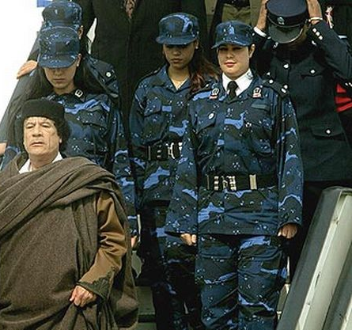
Military
A rising dictator needs to have strongmen ( or women ). A private army that can be used to intimidate opponents, attack your real or made up enemies ( scapegoats ) and make the dictator look like a strong, heroic leader. At first a dictator may use local bullies and militia groups. However, once in power a dictator must have the real deal army under their thumb.

Slide 15
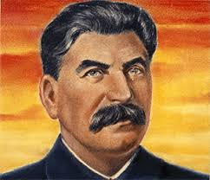
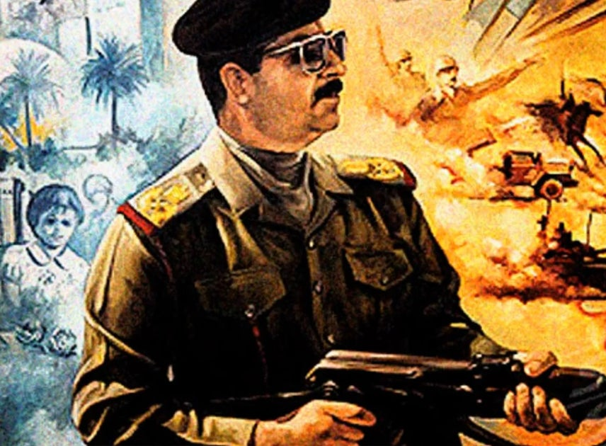
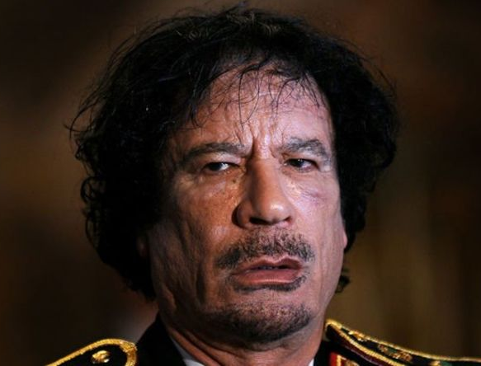
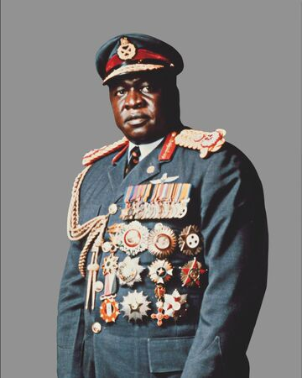
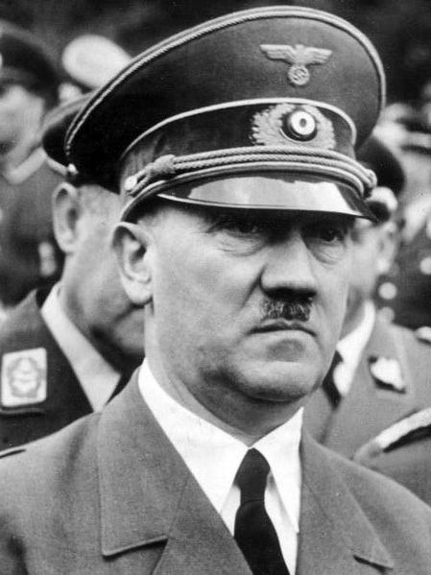
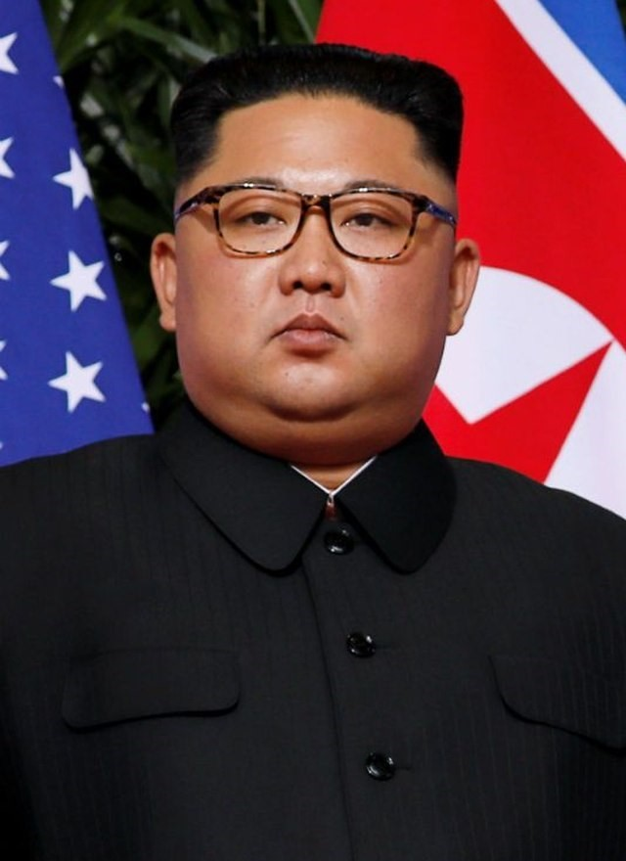
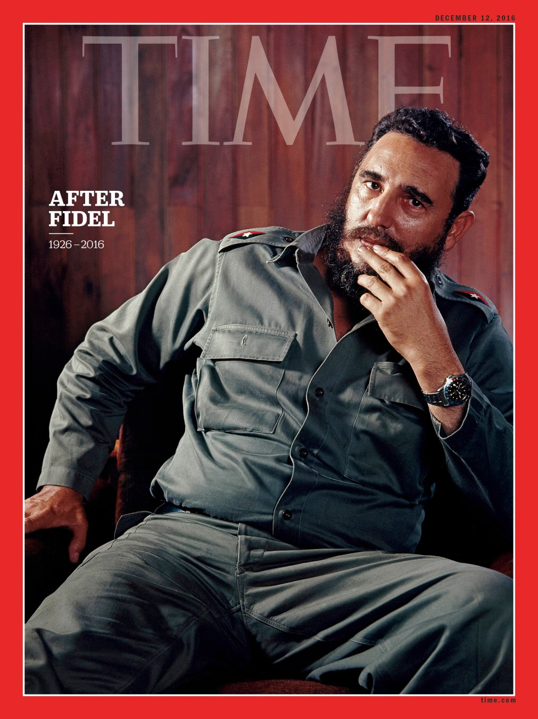
Stalin
Gaddafi
Saddam Hussein
Idi Amin
Vladimir Putin
Adolf Hitler
Fidel Castro
Kim Jong Un

Slide 16
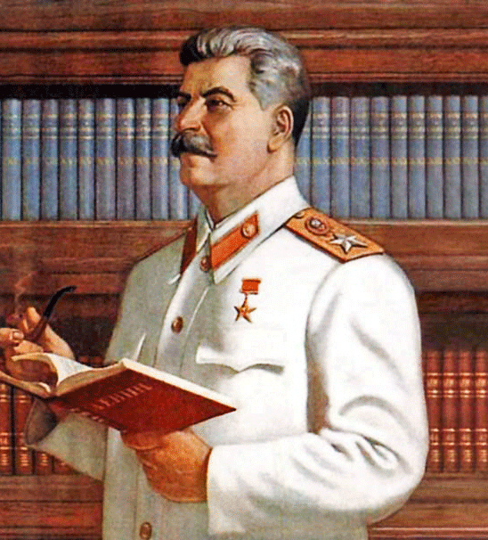
Joseph Stalin
Country - Soviet Union. When in power – 1922 / 53.
Famous for – Gulags and purges. Strengths – Cult of personality and Fear and Terror.
Weakness – economic policies and lack of loyalty.

Slide 17
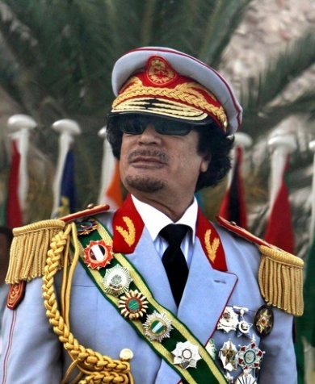
Colonel Gaddafi
Country - Libya When in power – 1969 to 2011 Famous for – Funding anti –American terrorist groups. Strengths – Cult of personality, creation of a police state.
Weakness – Squandering of vast oil reserves, corruption and neglect of many groups in society.

Slide 18
Idi Amin
Country – Uganda. When in power – 1971 to 1979. Famous for – Murder of 300 000 and named the ‘Butcher of Uganda.’ Strengths – Fear and terror, nationalist propaganda.
Weakness – unpredictable character, military failures.

Slide 19
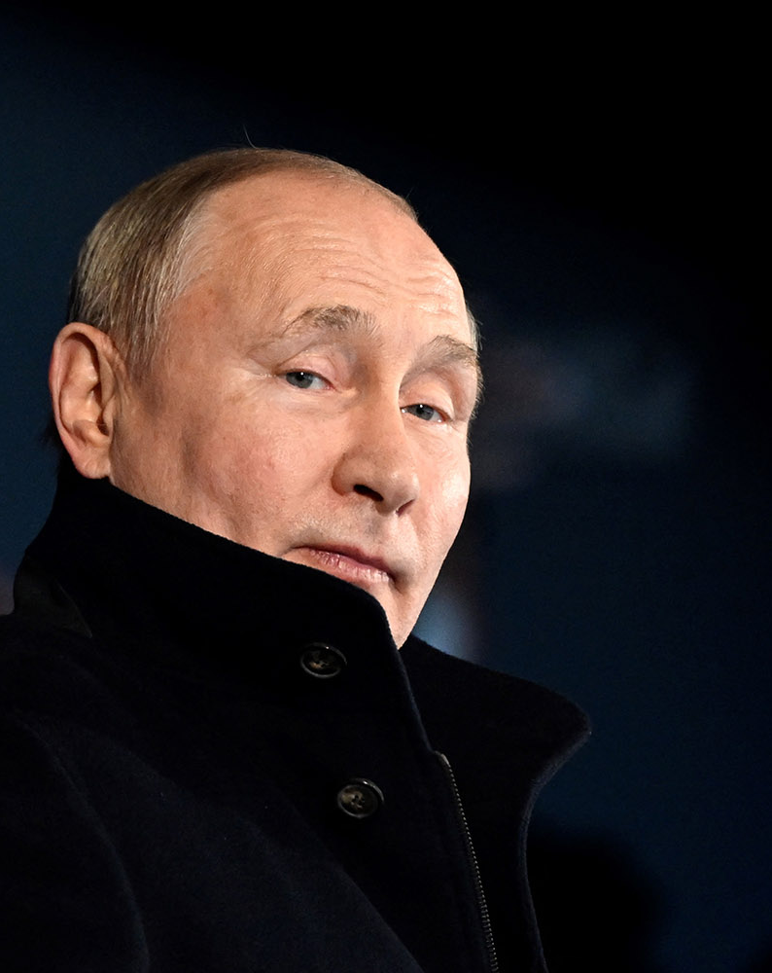
Vladimir Putin
Country - Russia When in power – 2012 to present. Famous for – Challenging the USA / NATO invading Ukraine. Strengths – Control of state media, personal wealth, and destabilising the West
Weakness – Paranoia, costly invasions.

Slide 20
Fidel Castro
Country - Cuba When in power – 1959 to 2008 Famous for – Siding with the Soviet Union against the USA during the Cold War. Strengths – Social support / reforms, creation of a one party state and elimination of opposition.
Weaknesses – Economic policies and
growth of industry.

Slide 21
Adolf Hitler
Country - Germany. When in power – 1933 to 45.
Famous for – Murder of 6 million Jews.
Strengths – Nation building + creating scapegoats.
Weakness – Controlling religion, military failures.

Slide 22
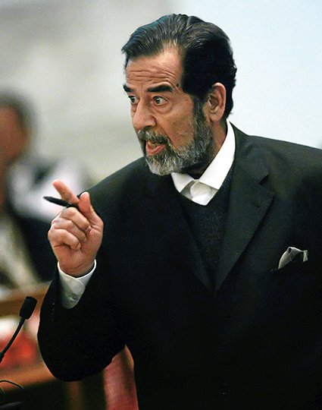
Saddam Hussein
Country - Iraq When in power – 1979 - 2003 Famous for – Leading Iraq in the Gulf Wars against The West. Strengths – Eliminating political rivals, propaganda.
Weakness – Arrogance / military failures.

Slide 23
Kim Jong Un
Country – North Korea When in power – 2011 to present. Famous for – Murder of potential rivals and possible family members. Strengths – Obtaining loyalty via propaganda, fear and cult of personality.
Weakness – Economic policies / health and conditions of North Korean people.

