Slide 1
The English CIVIL wars
by icHistory

Slide 2
Navigation and action buttons
Click to return to the main menu.
Click to return to sub menus.
Click the YouTube symbols on pages to connect to external videos. (There is a good summary attached here too )
Click the PDF symbol on pages to access free supporting student resources, PowerPoint and worksheets.

Slide 3
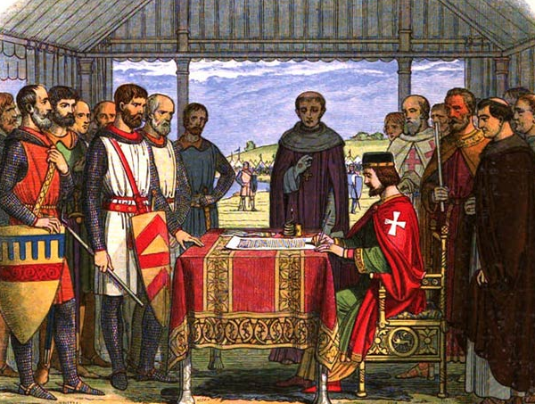
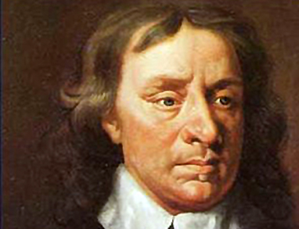
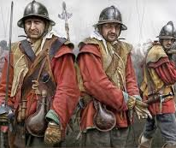
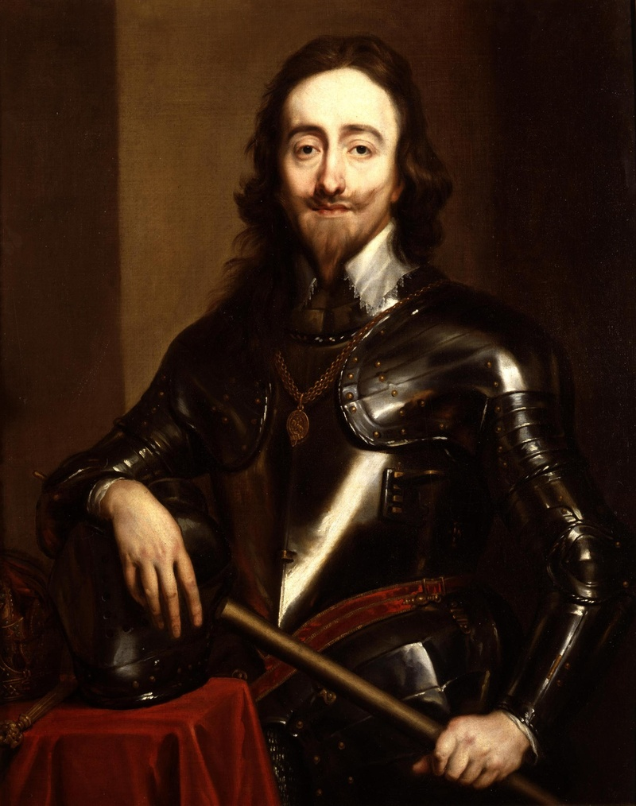
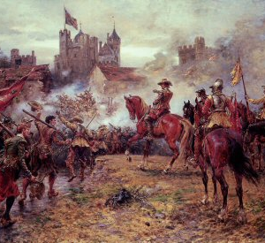
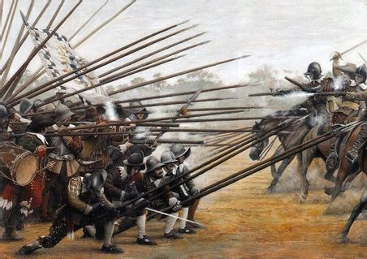
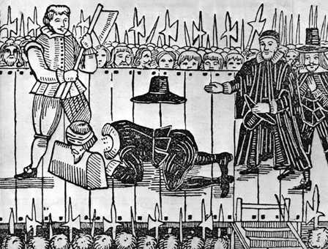
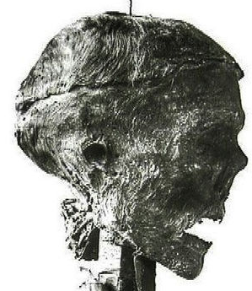
Click on each image to find out more.
CAUSES OF THE WAR
BACKGROUND
ARMIES AND WARFARE
WHO IS WHO?
TRIALS AND EXECUTIONS
THE THREE CIVIL WARS
REVIEW + LEGACY
THE SECOND CIVIL WAR

Slide 4
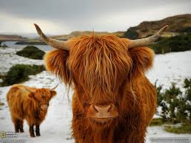
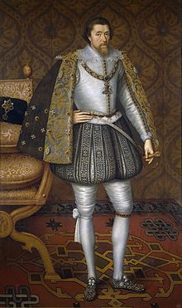
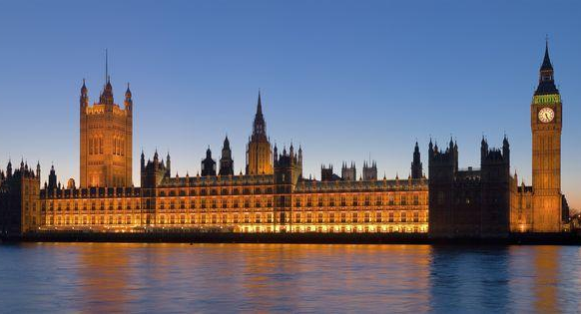
Starter … guess the causes of the ECW
Click icon right to download free supporting resources Click on each image to find out more

Slide 5
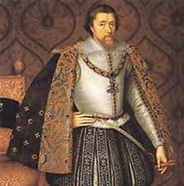
JAMES VI AND I
JAMES VI AND JAMES I
James VI of Scotland became James I of England when Elizabeth Tudor died in 1603. After the ‘Golden Age’ of rule under Elizabeth, James set the country on a path towards Civil War.
He was a strong believer in the Divine Right of Kings, the idea that the king was chosen and was second only to God. This belief meant he often made new laws or rules without asking the permission of Parliament. Decisions involving money and religion angered many members of Parliament and he even locked them out of the Houses of Parliament for 10 years!

Slide 6
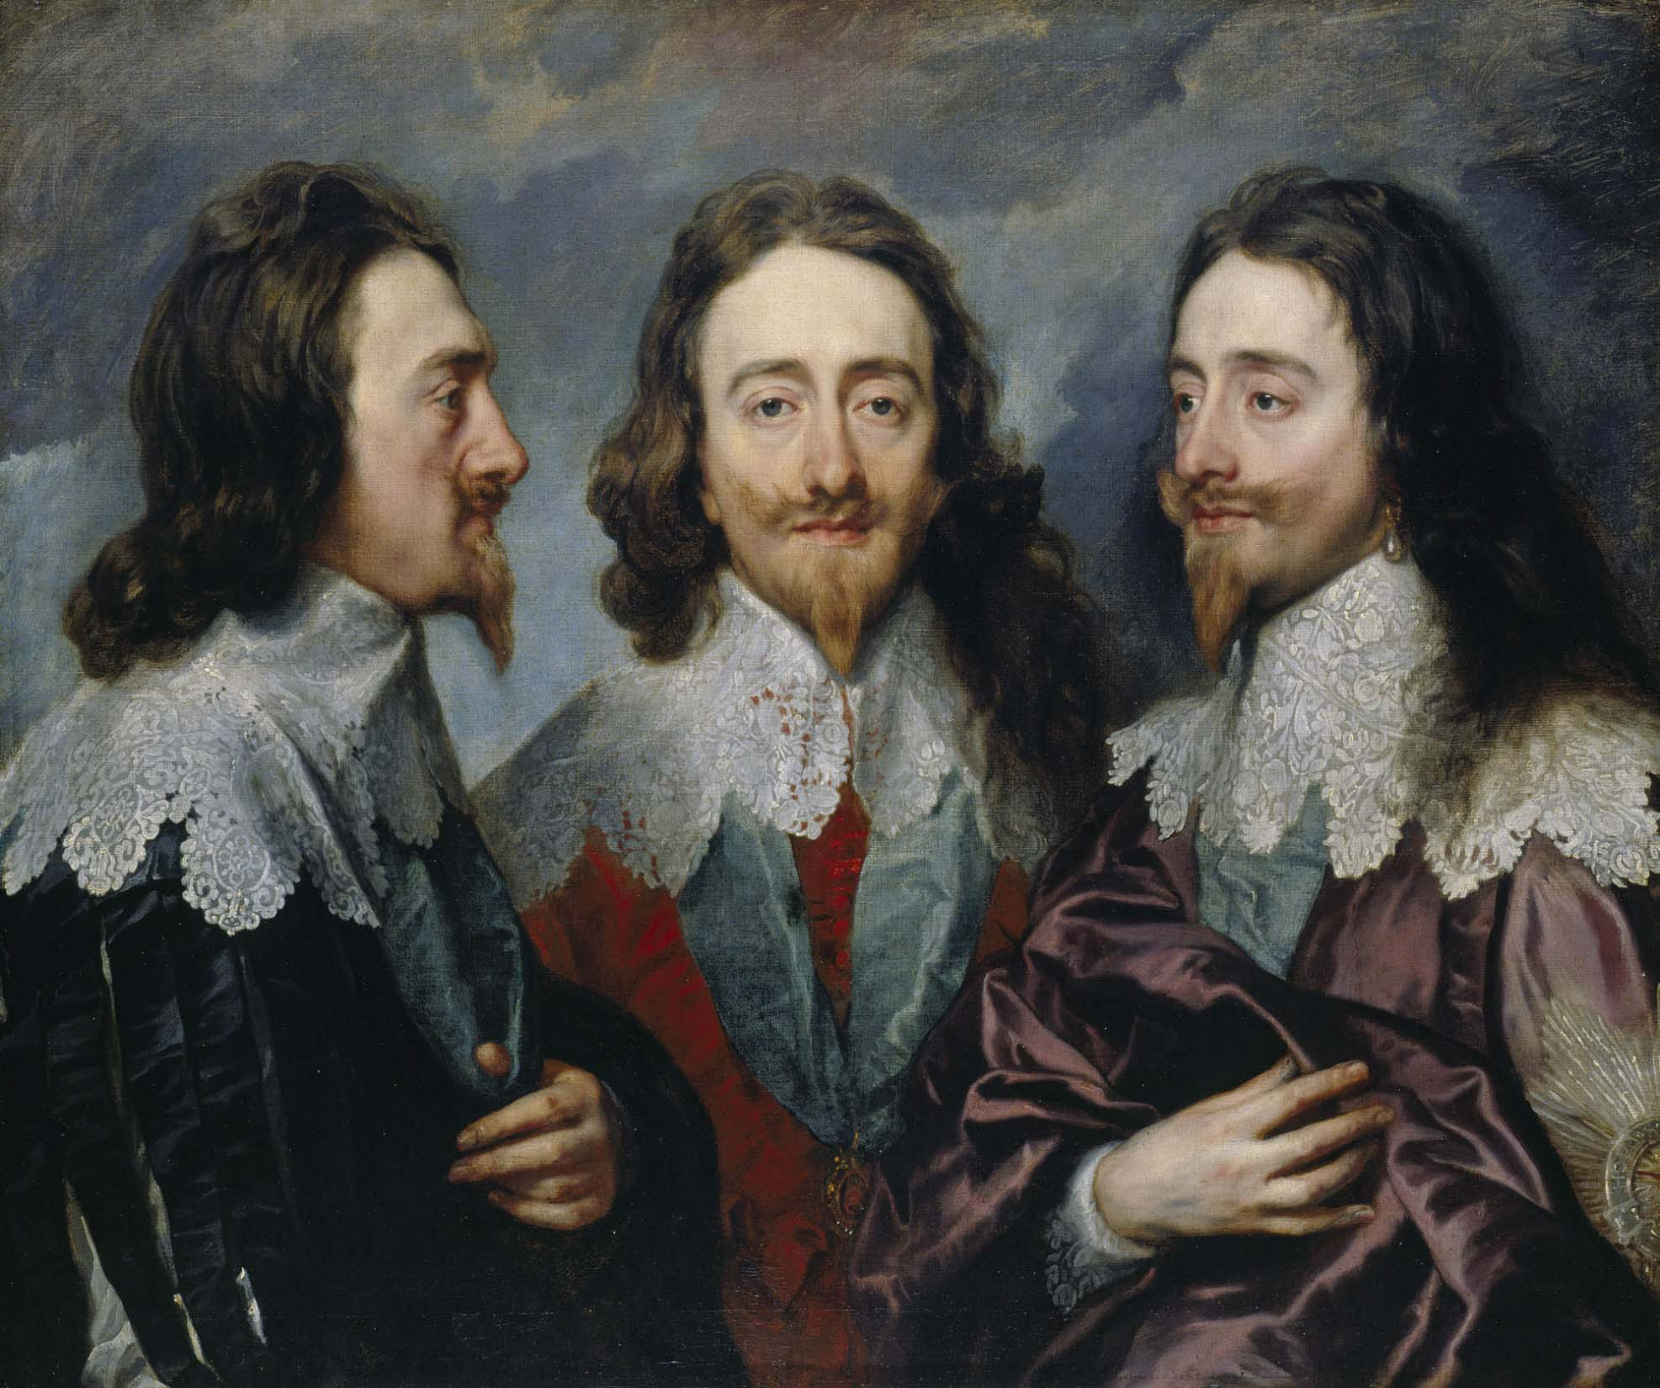
CHARLES I
Charles I was the son of James I. Like his father he was a strong believer in the concept f the Divine Right of Kings. Charles was more arrogant ( big headed ) and conceited ( looked down on others ) than his father. He continued to battle with Parliament over similar things just like his father - money, religion and decision making. Charles closed Parliament ruled without it during his ‘11 Years of Tyranny’.
CHARLES I

Slide 7
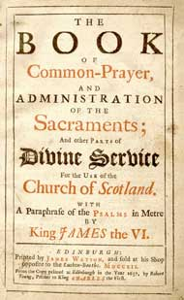
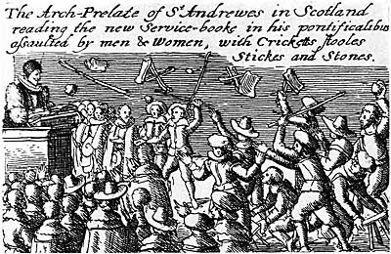
RELIGION
When the Pope refused to give Henry VIII the divorce he wanted from Catherine of Aragon, Henry broke away from the Catholic Church. Following the Act of Supremacy in 1534, there were many years of religions problems and fights between Protestant, Catholics and Puritans as each group fought to protect their beliefs and forms of worship.
Charles was married to a French Catholic, Henrietta Maria, so Puritans often accused him of having Catholic beliefs too.
In 1637, Charles introduced a new prayer book to Scotland book which was seen as being a move back towards a more Catholic form of worship.
RIOTS IN SCOTLAND

Slide 8
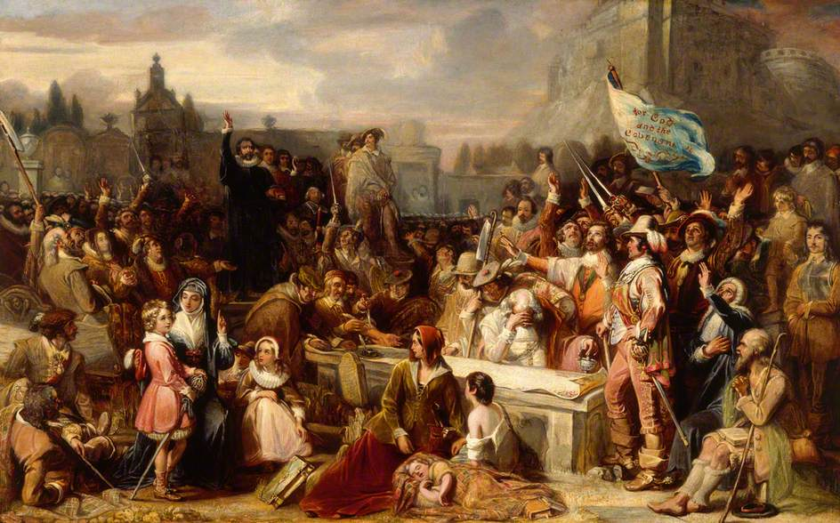
SCOTLAND
The Scottish nobles were aggressive and held a general dislike for England and the rule of Charles I. They encouraged rebellions against the king’s orders and the Scots invaded England in 1639.

Slide 9
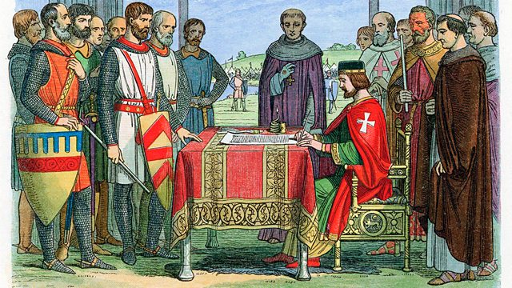
PARLIAMAENT
In 1215, the leading English barons forced King John to sign the Magna Carta. By doing this they had challenged the idea of the Divine Right of Kings. As the years passed it became more accepted that the king needed to discuss and get approval for important decisions with Parliament. In 1641, MP John Pym presented the Grand Remonstrance to King Charles I listing over 200 complaints about his rule.
THE HOUSES OF PARLIMAENT TODAY
THE SIGNING OF THE MAGNA CARTA IN 1215

Slide 10
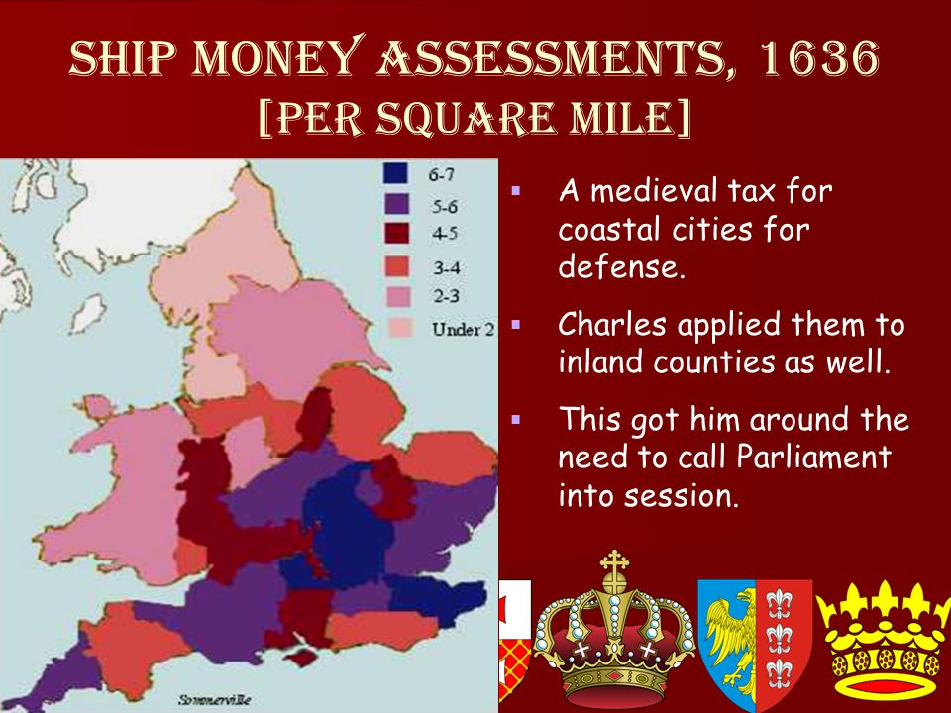
MONEY
Although James and Charles often made decisions without asking the permission of Parliament they needed Parliament to help raise money in the form of taxes. One of the major clashes under the rule of James came after Parliament told the king they would not support their him with the raising of Custom Duties. Similarly, Charles argued over money. He used a Star Court Chamber to essentially force rich men to pay for titles or face fines. Charles also angered many people when he ordered that all people pay Ship Money. This had traditionally only been paid by people living near the sea.

