Slide 1
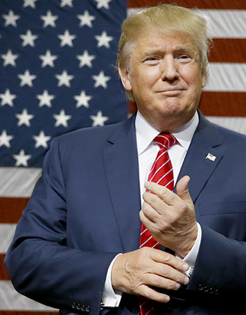
Propaganda

Slide 2
Navigation and action buttons
Click to return to the main menu.
Click this symbol on pages to ensure you follow the correct navigation path of the PowerPoint.
Click this symbol on pages to connect to external YouTube videos.
4
The yellow circle denotes an activity on the accompanying student workbook.
Click this PDF symbol ( now ) to access the supporting student resources, PowerPoint and worksheets.

Slide 3
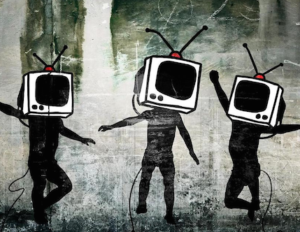
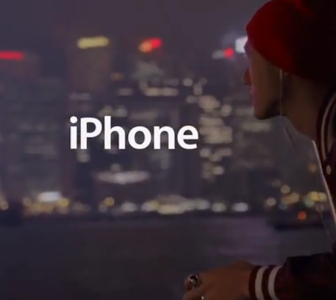
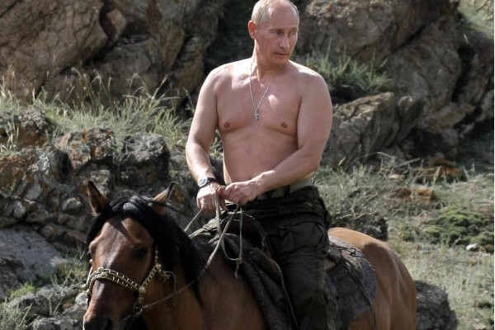
Click on each image to find out more.
LET’S GET STARTED
ARM YOURSELF
KNOW MOTIVE
KNOW BIAS
MODERN
ADVERTISEMENT
CLASSIC
FINALLY

Slide 4
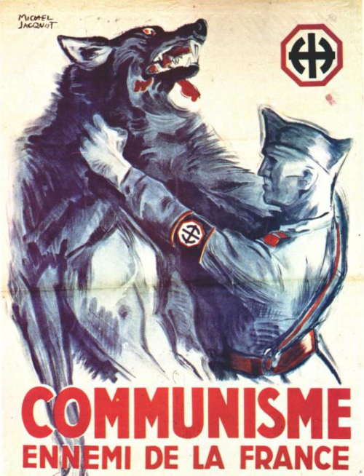
Use these definitions to help create your OWN definition of propaganda
Definition 3 In general, a message designed to persuade its intended audience to think and behave in a certain manner. Thus advertising is commercial propaganda.
It is the systematic spreading of information and/or disinformation, usually to promote a narrow political or religious viewpoint.
1
Definition 1 Information, especially of a biased or misleading nature, used to promote a political cause or point of view.
Definition 2 Propaganda is the spreading of information in support of a cause. It’s not so important whether the information is true or false or if the cause is just or not.

Slide 5
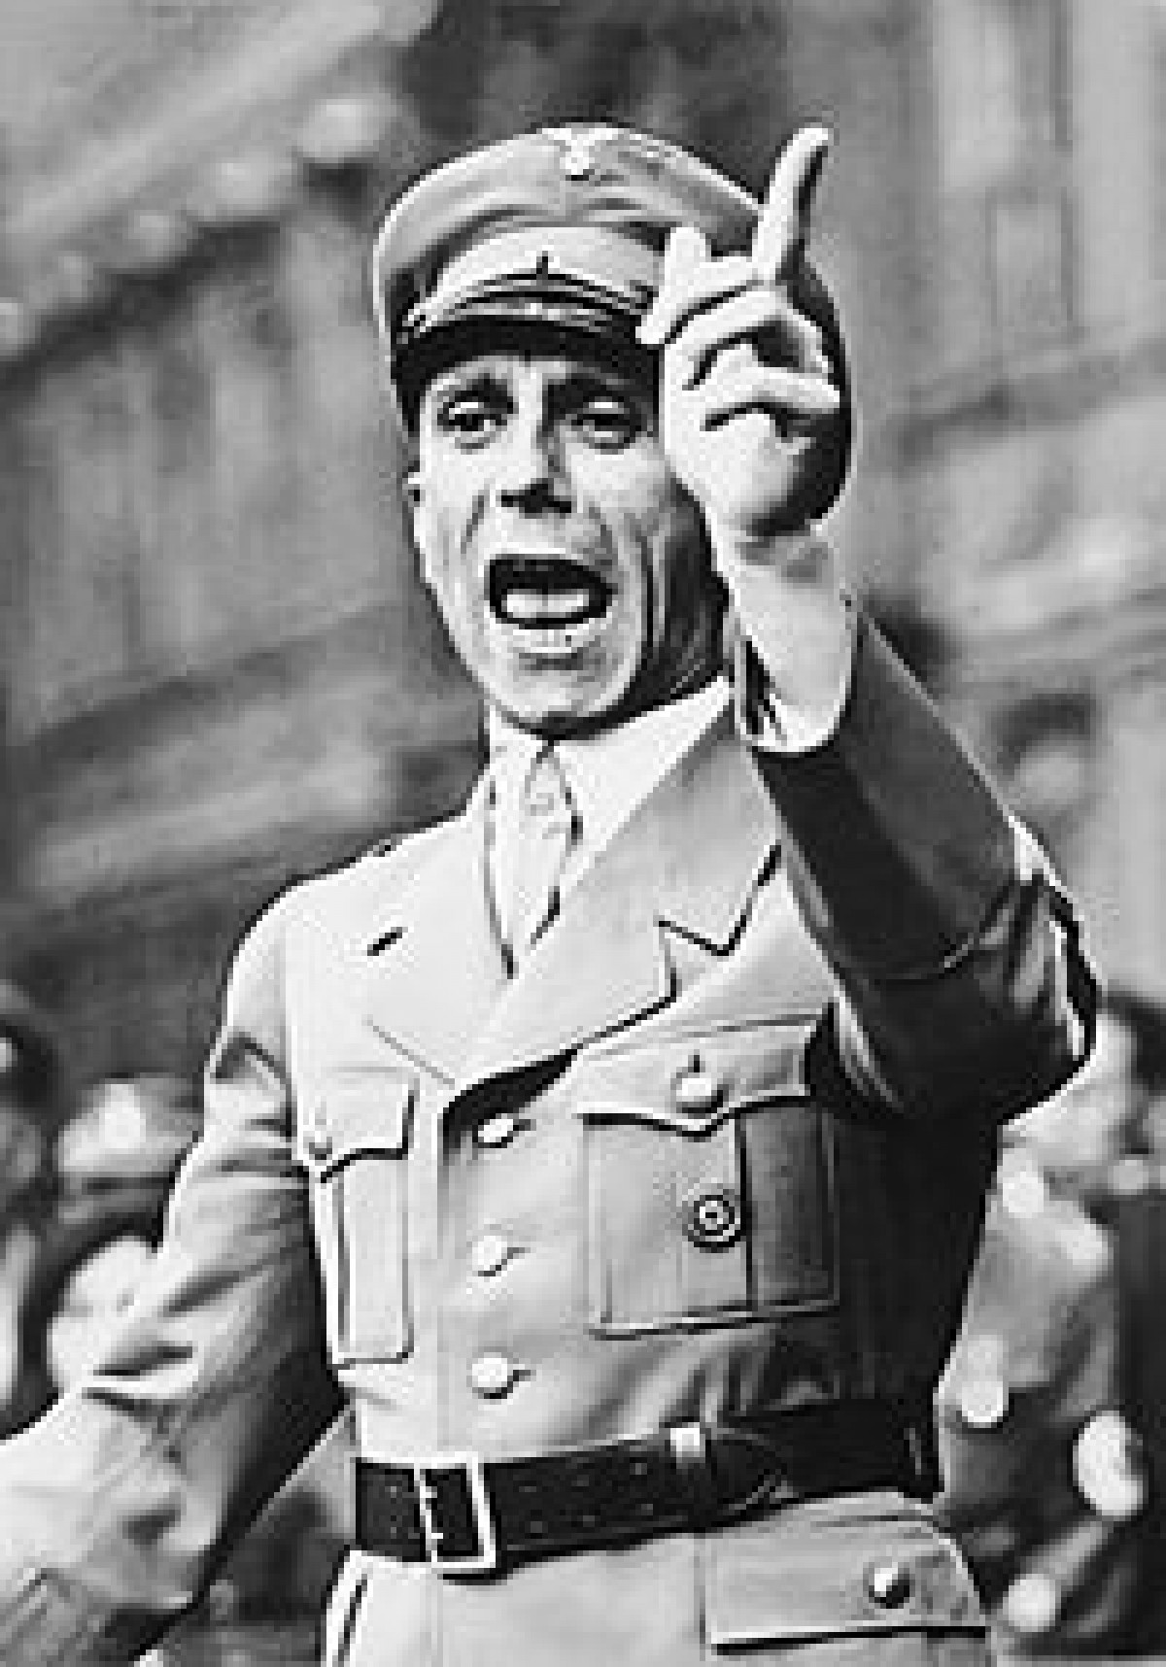
The Master of Propaganda
‘If you tell a lie big enough and keep repeating it, people will eventually come to believe it. There was no point in seeking to convert the intellectuals. For intellectuals would never be converted and would anyways always yield to the stronger, and this will always be ‘the man in the street.’ Arguments must therefore be crude, clear and forcible, and appeal to emotions and instincts, not the intellect. The rank and file are usually much more primitive than we imagine. Propaganda must therefore always be essentially simple and repetitive.’ Joseph Goebbels: Nazi Minister for Propaganda and Enlightenment c 1942.
2

Slide 6
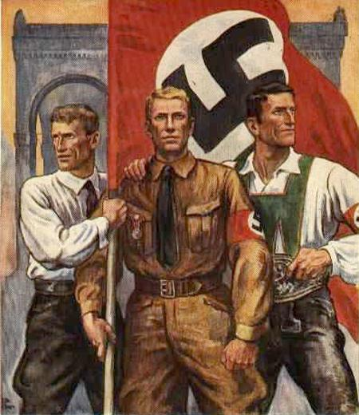
PROPAGANDA Techniques
4
5
3
Watch this clip for some classic bandwagoning
6

Slide 7
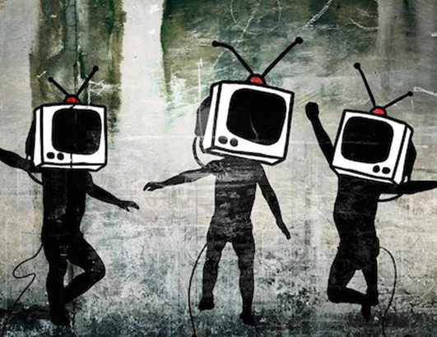
Skill - Interpretation
Go back to menu …
7

Slide 8
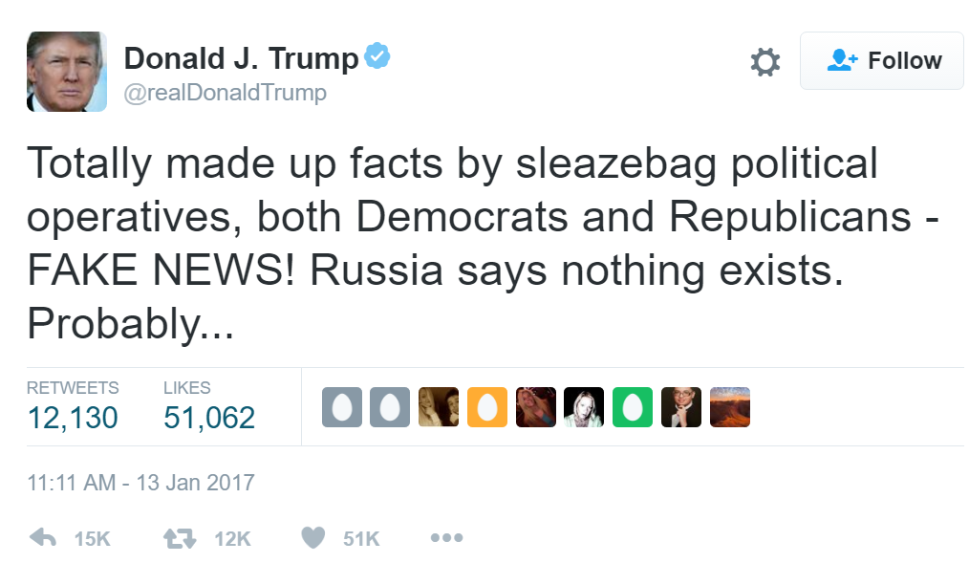
B
BIAS
igoted
Arrogant. Only interested in own opinion. Not tolerant of other people’s beliefs or opinions.
Bias and Propaganda go hand in hand … propaganda contains EXTREME types of bias in an attempt to influence or persuade. Try to remember the BIASED indicators shown left when judging the reliability of source content. We are impacted by BIAS every day. We are all BIASED often without realising it. This is called unconscious bias. Discuss examples of unconscious bias that you may have ….
I
s One-Sided
Focus only on the good or bad. Not at all balanced. Subjective not objective.
A
bout ‘Me’
Boasts about own achievements OR disrespects those of others.
S
trong Language
Contains reactive, emotional, strong words (e.g. superlatives ) look out for use of CAPS and !!!!!!
E
xaggerates
Takes the truth but makes it much smaller or bigger. Or may just lie.
8
D
oesn't Add Up
The information is not corroborated by other more reliable sources of information.

Slide 9
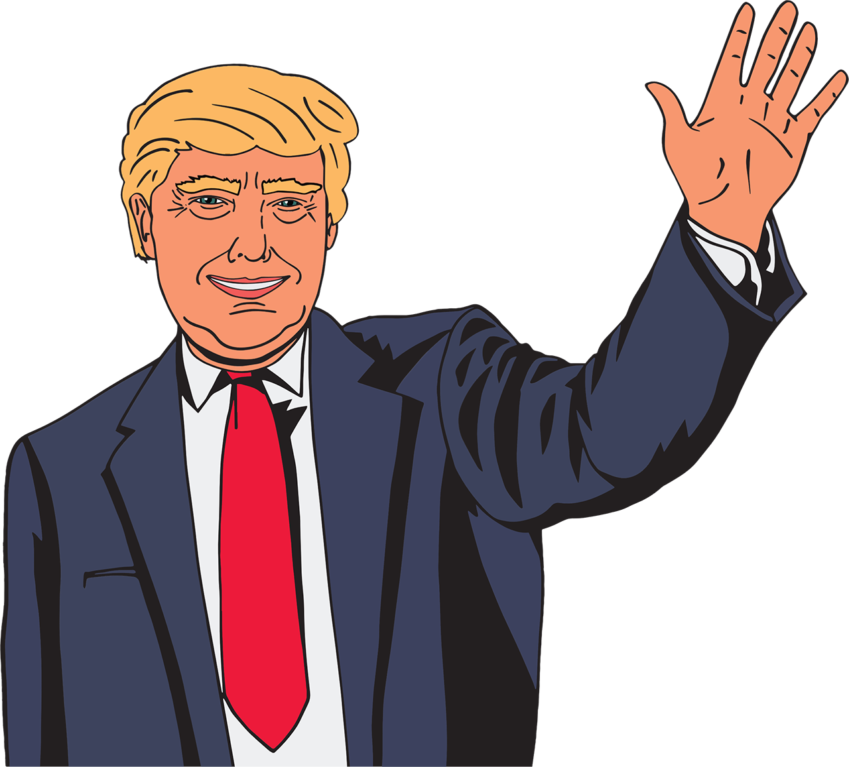
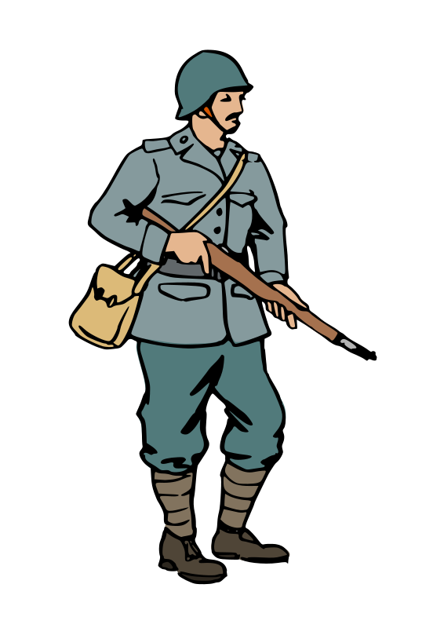
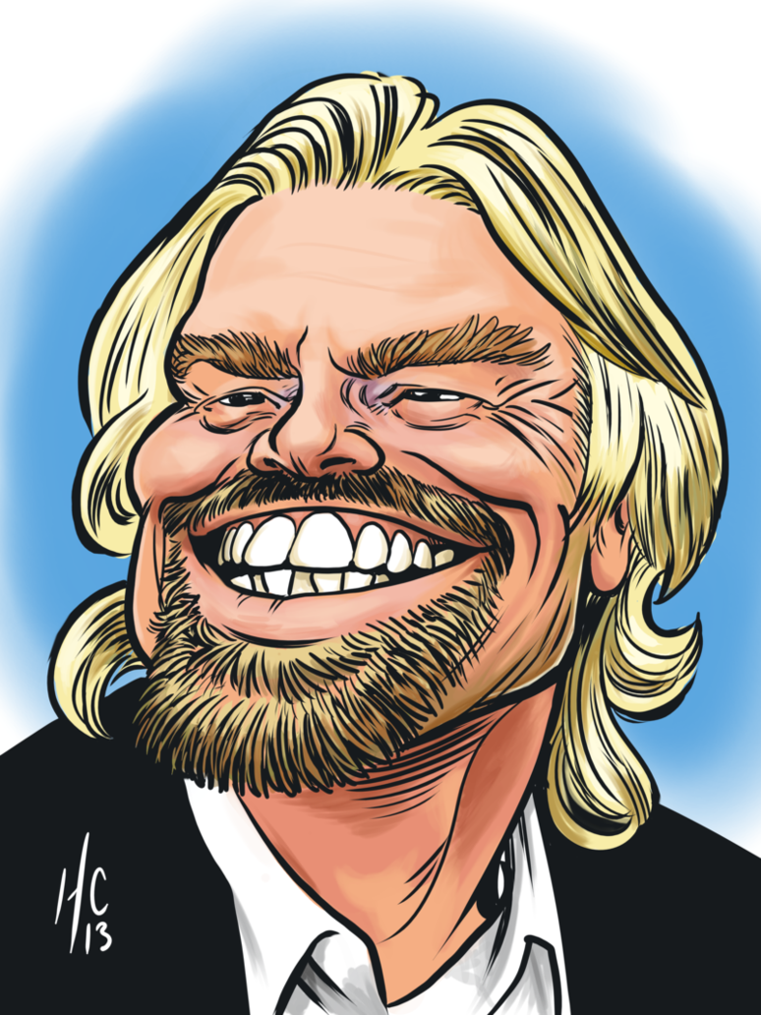
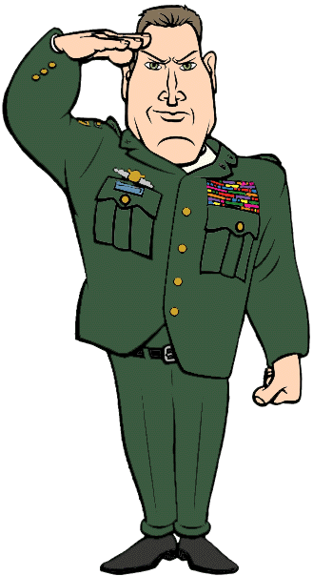
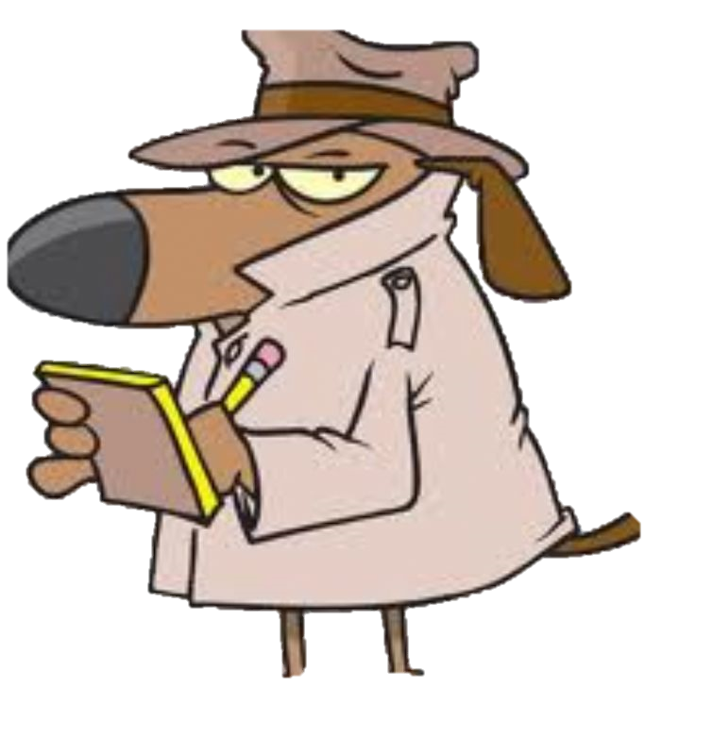
MOTIVE
When studying propaganda, persuasion and bias it is important to consider MOTIVE or WHY. There are many reasons why a person or group may have the motive to persuade or lie to others. EVERYONE tells lies or tries to persuade others at times and for different motives. We even lie to ourselves … can you think of an example of this? Is it EVER ok to lie?
9
President
Historian
Soldier
CEO
YOU!
A Friend
Teacher
General
Reporter
Yes You!

Slide 10
ADVERTISING
15
One of the most common forms of propaganda is advertising. Adverts try and influence you to take an action - usually to buy something. The people who create adverts are very clever at making you think you want or need something even when you don’t. Which of the ‘Propaganda devices’ are used in the adverts linked below… Recommended = Tango, Panda and Bullet – first 7-8 minutes. Discussion point: have you ever bought something you that you didn’t really want or need?
Discovery | Panda | Hamlet | Nike | Smoking | Tango | Bullet

Slide 11
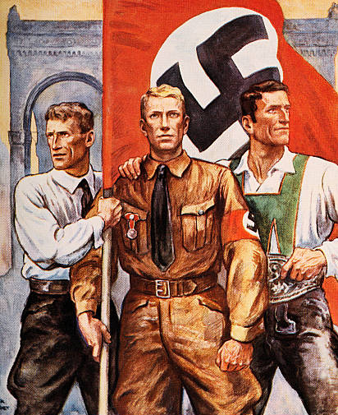
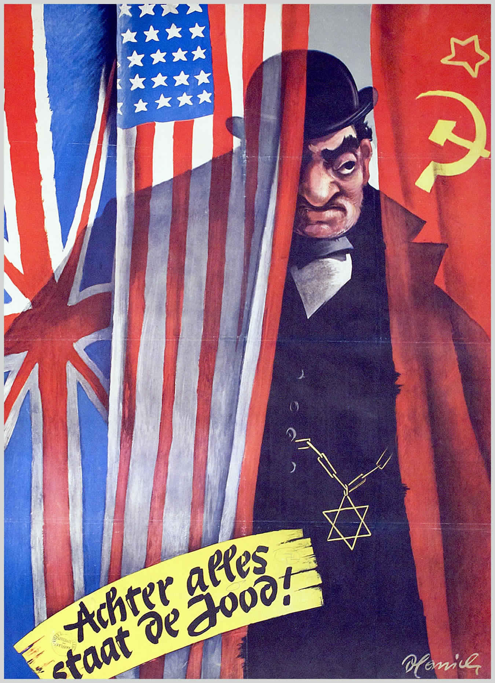
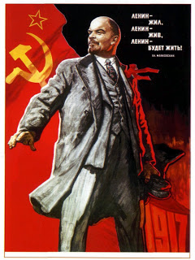
Classic Propaganda
NAZI GERMANY
GENERAL
RISE OF STALIN

Slide 12
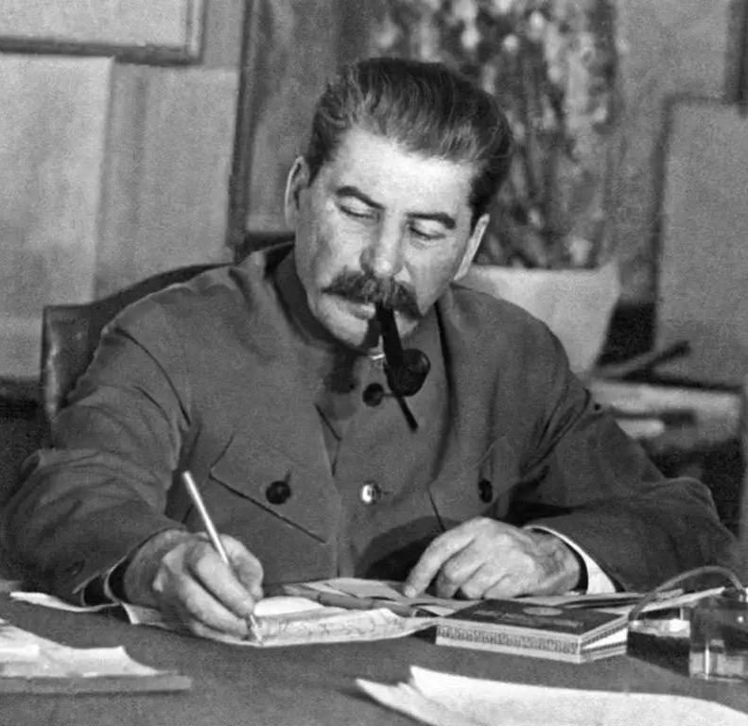
The Rise of Joseph Stalin
Following the forced abdication of Tsar Nicholas in March, 1917 the Bolsheviks rose to power in the October Revolution and declared the new Soviet Republic a one party state. The October Revolution in 1917 was led by Vladimir Lenin and Leon Trotsky and not Joseph Stalin. Before his death in 1924, Lenin had outlined his thought on Stalin and Trotsky. His beliefs and suggestion about who was the best fit to lead after his death were
written in ‘Lenin’s Testament’.

Slide 13
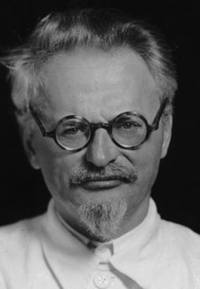
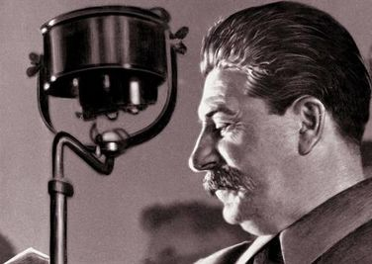
Lenin’s Testament
‘’Comrade Stalin, having become Secretary-General, has unlimited authority concentrated in his hands, and I am not sure whether he will always be capable of using that authority with sufficient caution. Comrade Trotsky, on the other hand, has already proved, is distinguished by outstanding ability and is perhaps the most capable man in Communist Party. But he has displayed excessive self-assurance and shown excessive preoccupation with the purely administrative side of the work. Yet, Stalin is too coarse and although quite tolerable in our midst becomes intolerable in a Secretary-General. I suggest that the comrades think about a way of removing Stalin and appointing another man in who differs from Comrade Stalin, being more tolerant, more loyal, more polite and more considerate to the comrades”. 1: Who did Lenin want to take over leadership of the Communist Party? Explain your answer using PEEL
Trotsky
Lenin
Stalin

Slide 14
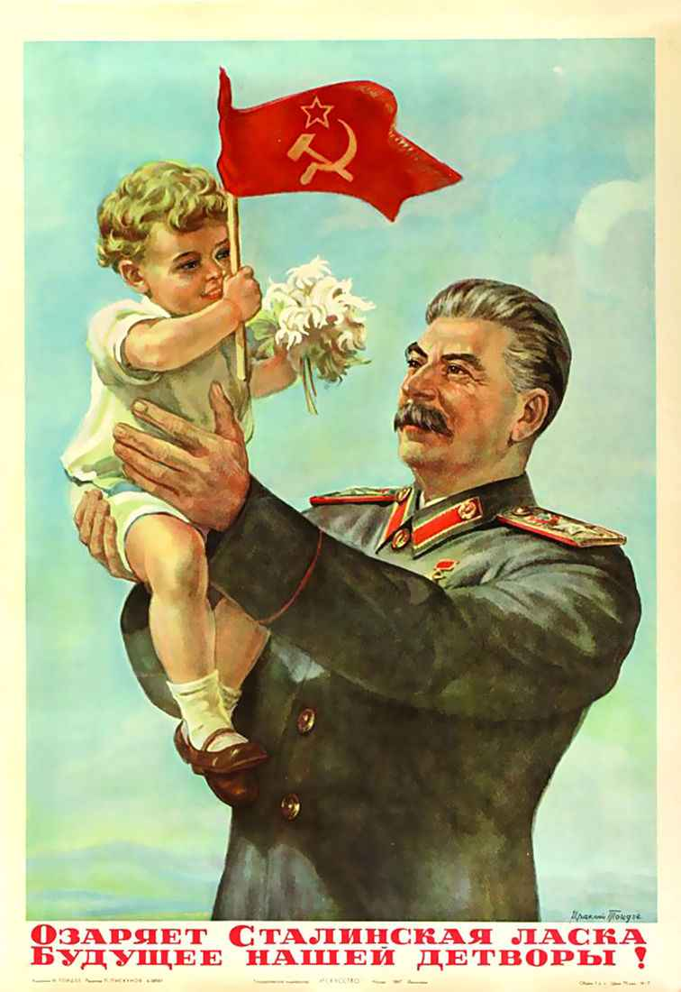
Stalin’s Use of propaganda
When Lenin died in 1924, Stalin set about his plan to take over full control of the Communist Party. His first act was to tell Trotsky the wrong date for Lenin's funeral. With Trotsky absent Stalin was able to position himself as the man closest to the dead hero of the October Revolution. Once in power, Stalin began erasing Trotsky from photographs and history books. He also exaggerated his own role in the takeover of Russia, had his name added to the national anthem, built statues of himself and named a city after himself – Stalingrad.

Slide 15
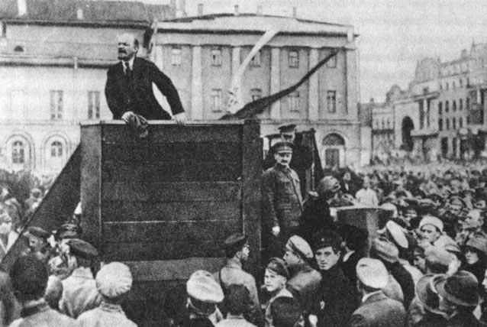

Slide 16
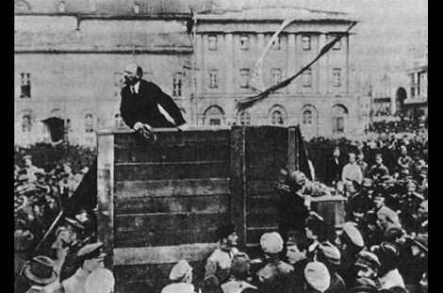

Slide 17
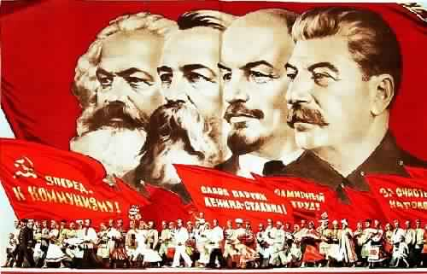
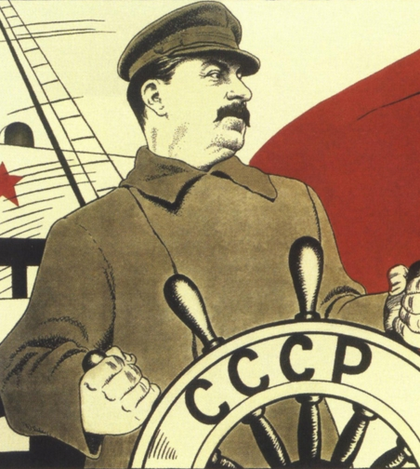
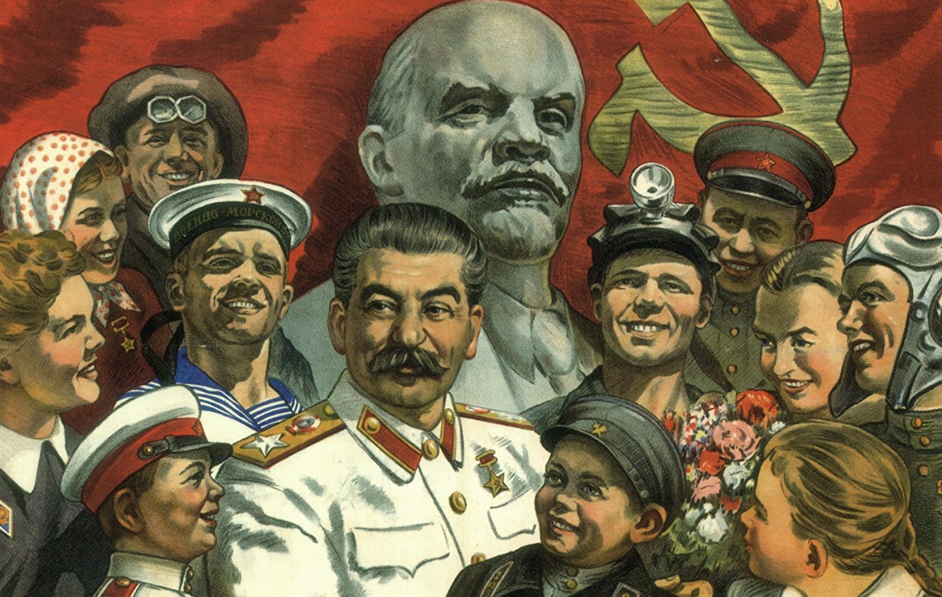
Message?
Message?
Message?

Slide 18
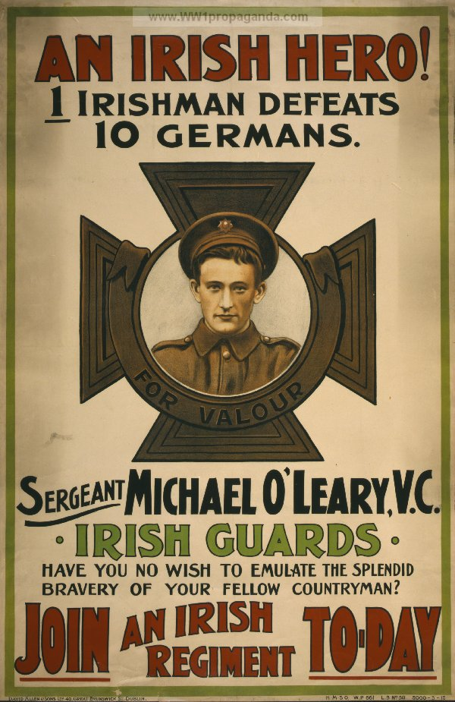
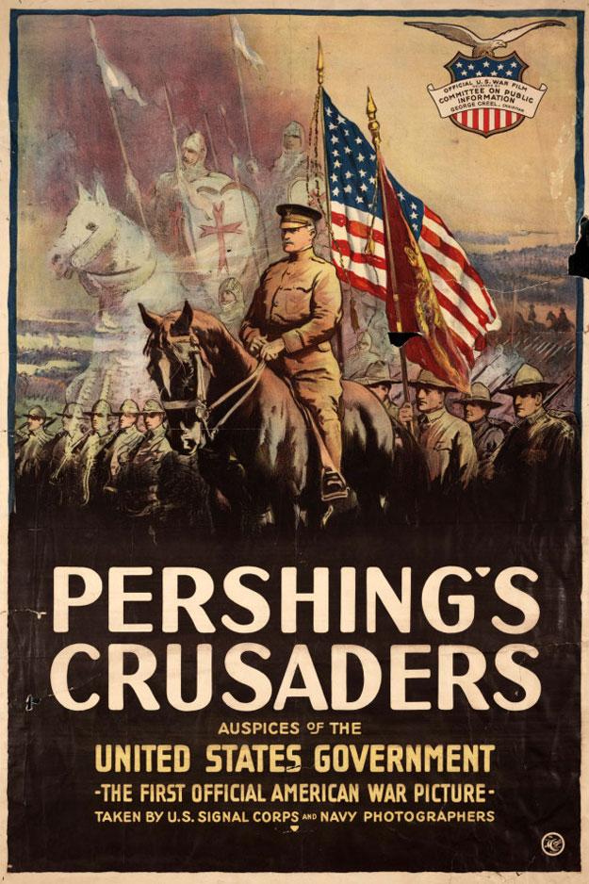
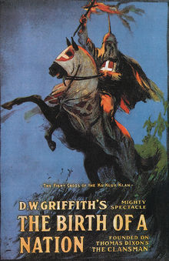
CLASSIC
CRUSADER
15
From 5:40
HERO
HAMMER
TRIUMPH
From 3 to 9 mins
BIRTH

Slide 19
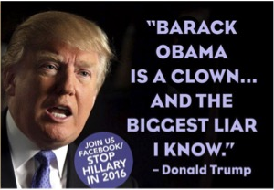
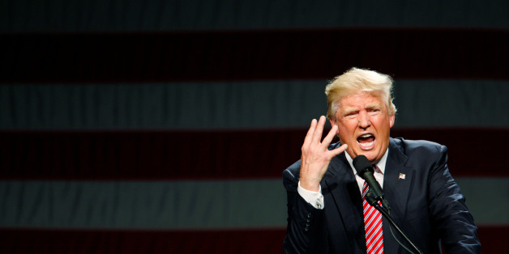
Modern ( Trump )
15
GREAT
MAGA
CLOWN
GRAPHIC
HERO
SUPPORT

Slide 20
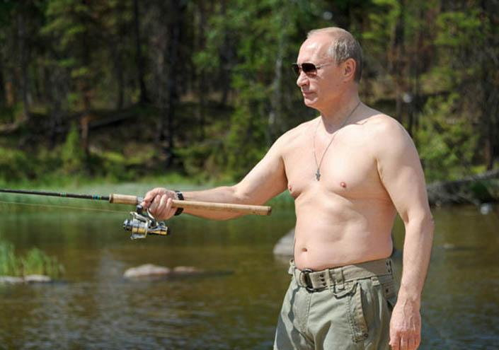
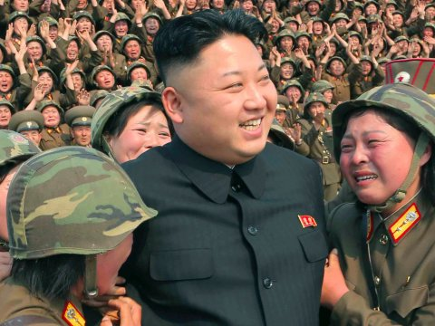
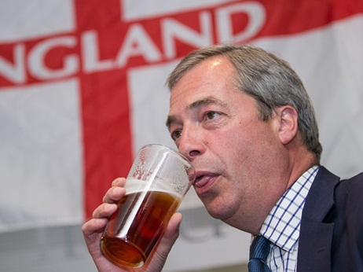
MODERN
15
WORSHIP
FISHING
NIGEL

Slide 21
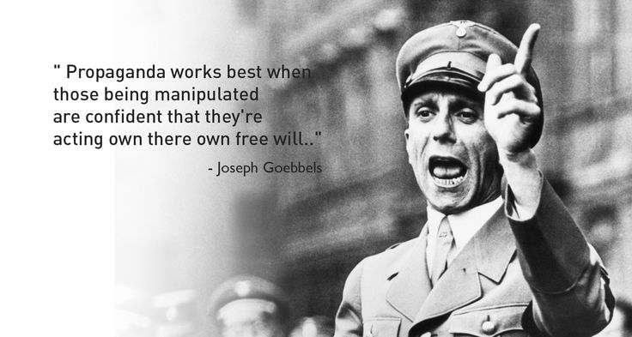
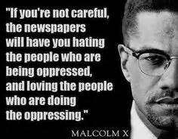
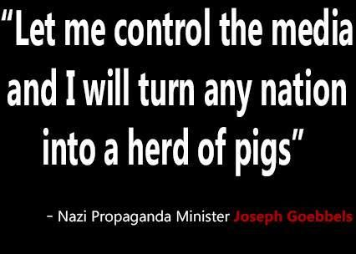
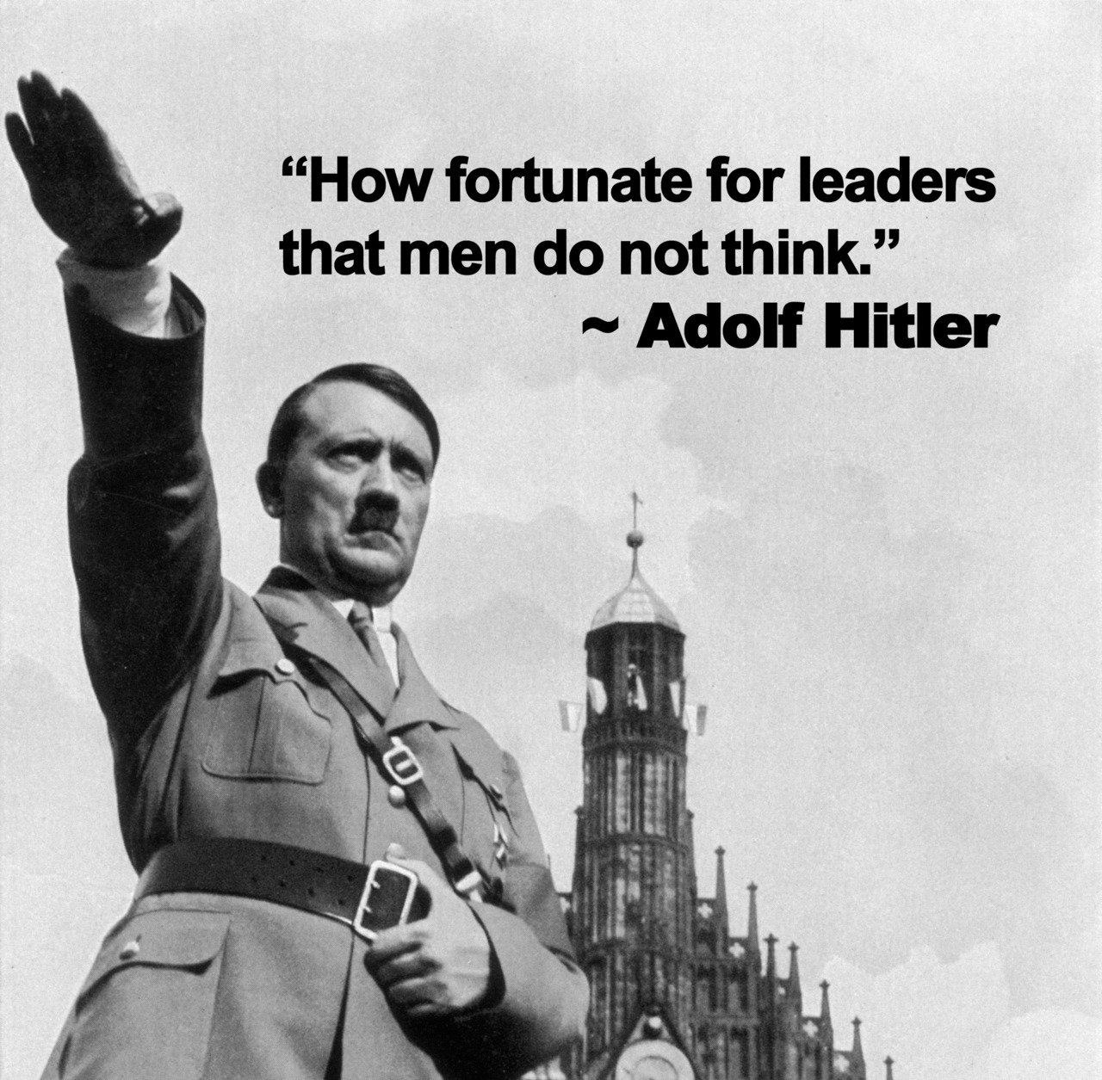
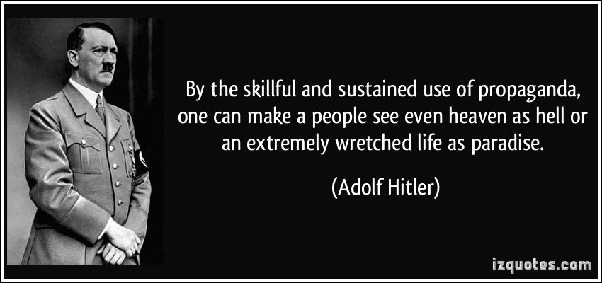
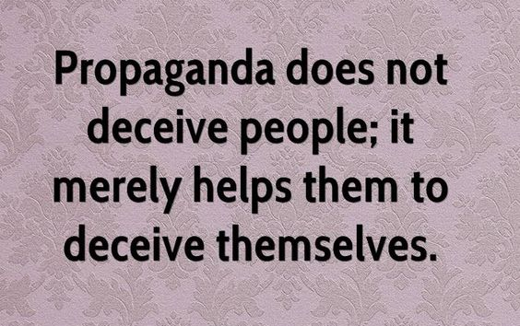
10

Slide 22
PROPAGANDA TODAY
It is very easy to fall into the thinking trap that what happened in the past is not longer important. However, the the past can really help us understand what is happening around us today. Propaganda is alive and kicking and surrounds us. Every day YOU are subject to people, businesses and group that want to influence you to do or think things that are not in your best interest or in the interests of others. Traditionally newspapers were responsible for spreading forms of propaganda, now social media is becoming increasingly important.
Social Media
Print Media

Slide 23
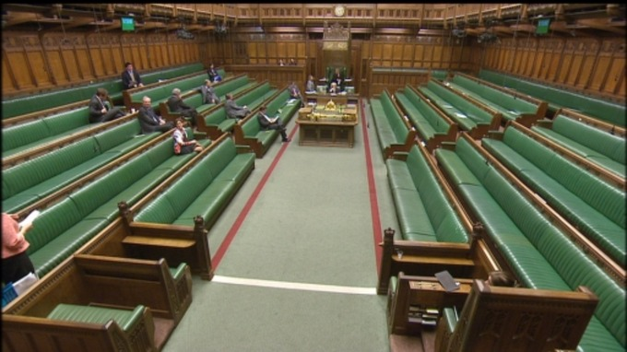
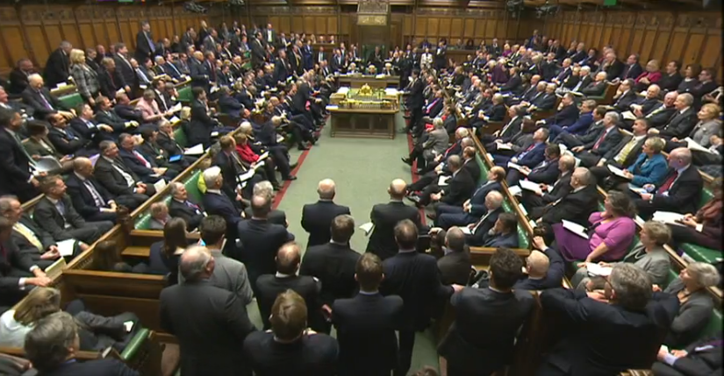
SOCIAL MEDIA
We are being increasingly influenced by social media and it is very effective at influencing our behaviour. When using social media we join groups, like pages or share things we identify with. This creates a vicious cycle in which we become increasingly caught in a bubble of information that reinforces our beliefs and biases. Another problem with this form of media is the difficulty in understanding he real origin of a source of information. The rise of ‘fake news’ that is quickly shared and spread and makes separating real news and the truth much more difficult as it gets lost all the noise. Also, when factual, truthful information is available it is easy for others to simply cry fake news. Click HERE for a good example of this. ‘Fake new’s is on the rise and worryingly become a weapon used by individual, groups and even governments. A recent example of ‘news’ spread on social media can be seen right. But it was entirely fake but was widely spread. Note: photos / images also need to be checked carefully and never taken at face value.
Discussion point: What are the solution to the ‘dangers’ of getting information via social media?
MPS PRESENT TO VOTE ON DISBALED WELFARE
11
MPS PRESENT TO VOTE ON THEIR OWN PAY RISE

Slide 24
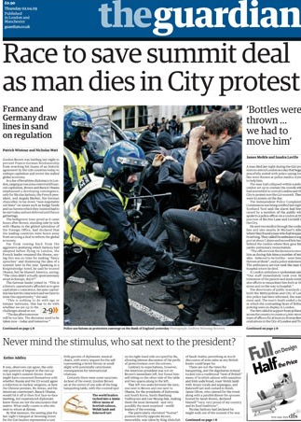
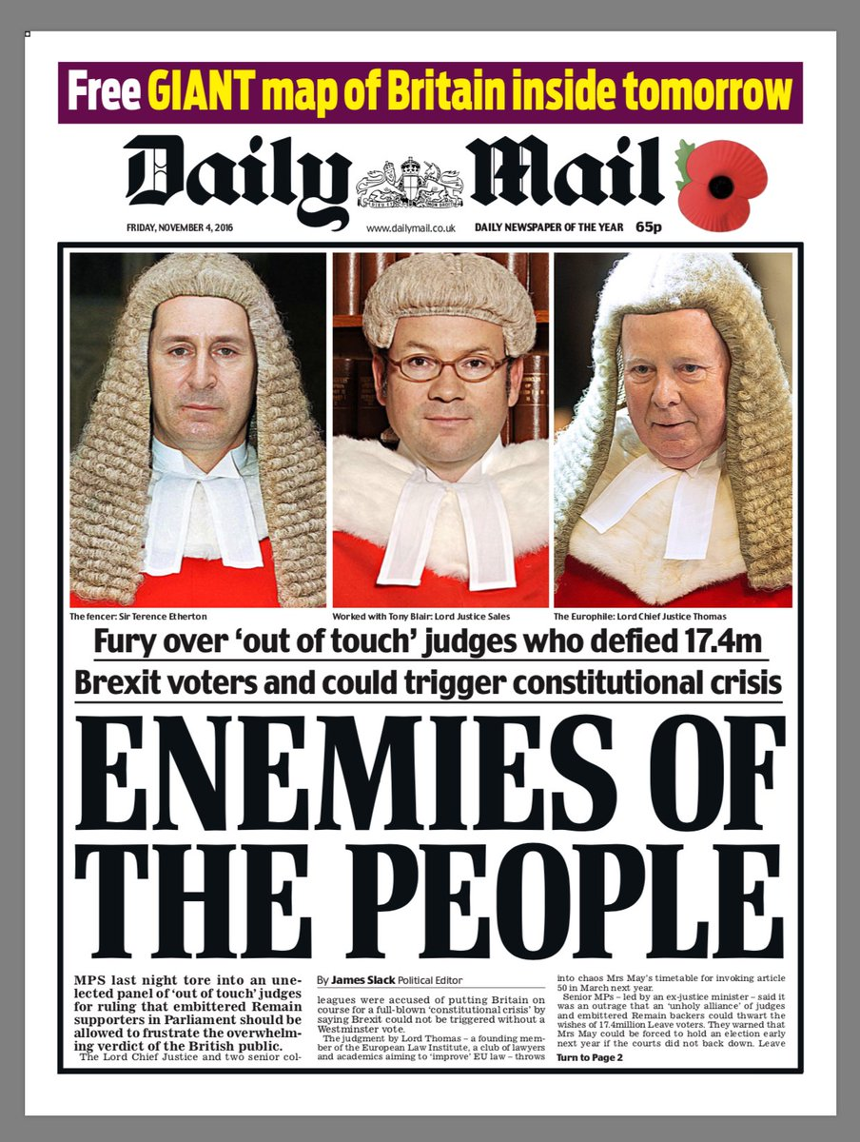
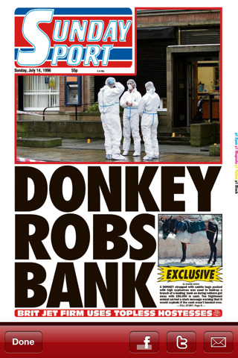
PRINT MEDIA
As a ( very smart ) student of history you understand it is important to question ALL sources of information.
Some newspapers and journalists take great pride n their work and carefully investigate and check information before publishing. However, not all newspapers or journalists are as professional. Most newspapers have a leaning and push stories to support one political party or attack another. Discuss: rank order these newspapers in terms of their reliability.
12
It is important to educate yourself as to which newspapers or media are professional, reliable and trustworthy
13

Slide 25
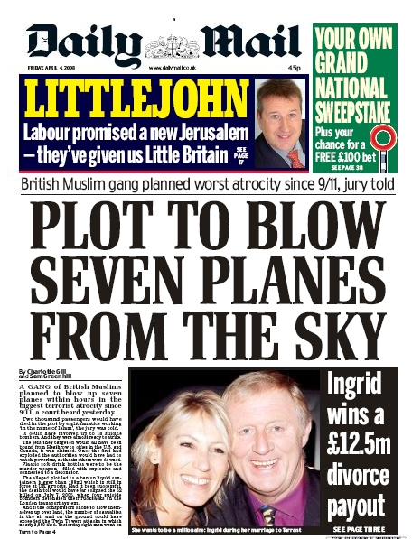
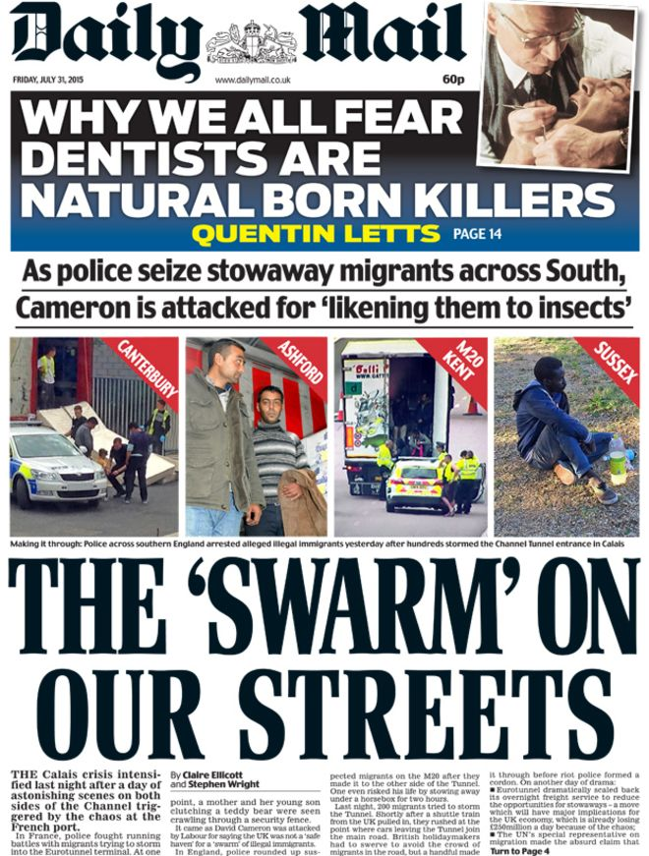
PLAYING ON EMOTIONS
Propaganda plays on EMOTIONS such as loyalty, pride and love. Task: identify the emotion the following headlines target.
14

Slide 26
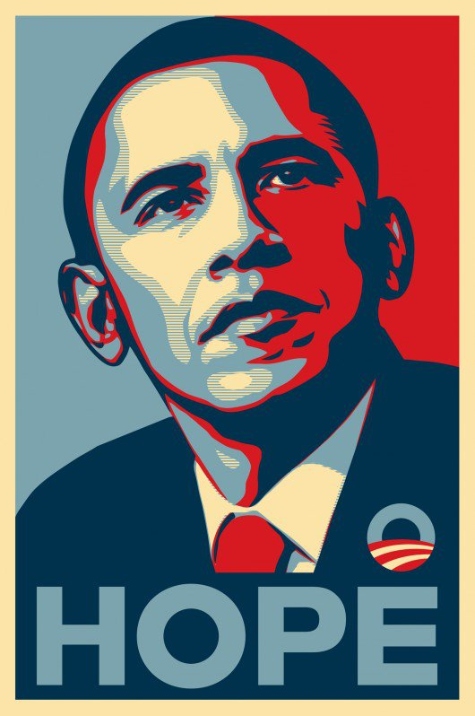
FEEDBACK
If you have any suggestions, ideas or resources to support with the teaching of propaganda please email me.
phil@ichistoy.com

